Slide 1
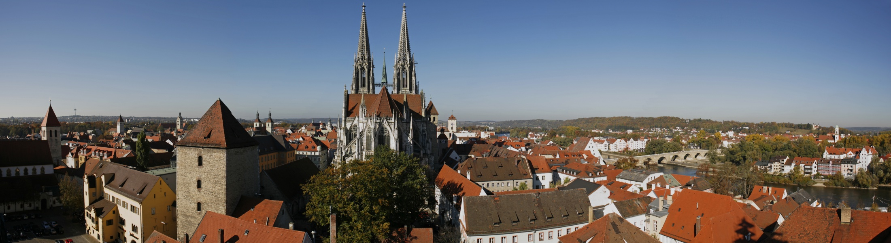
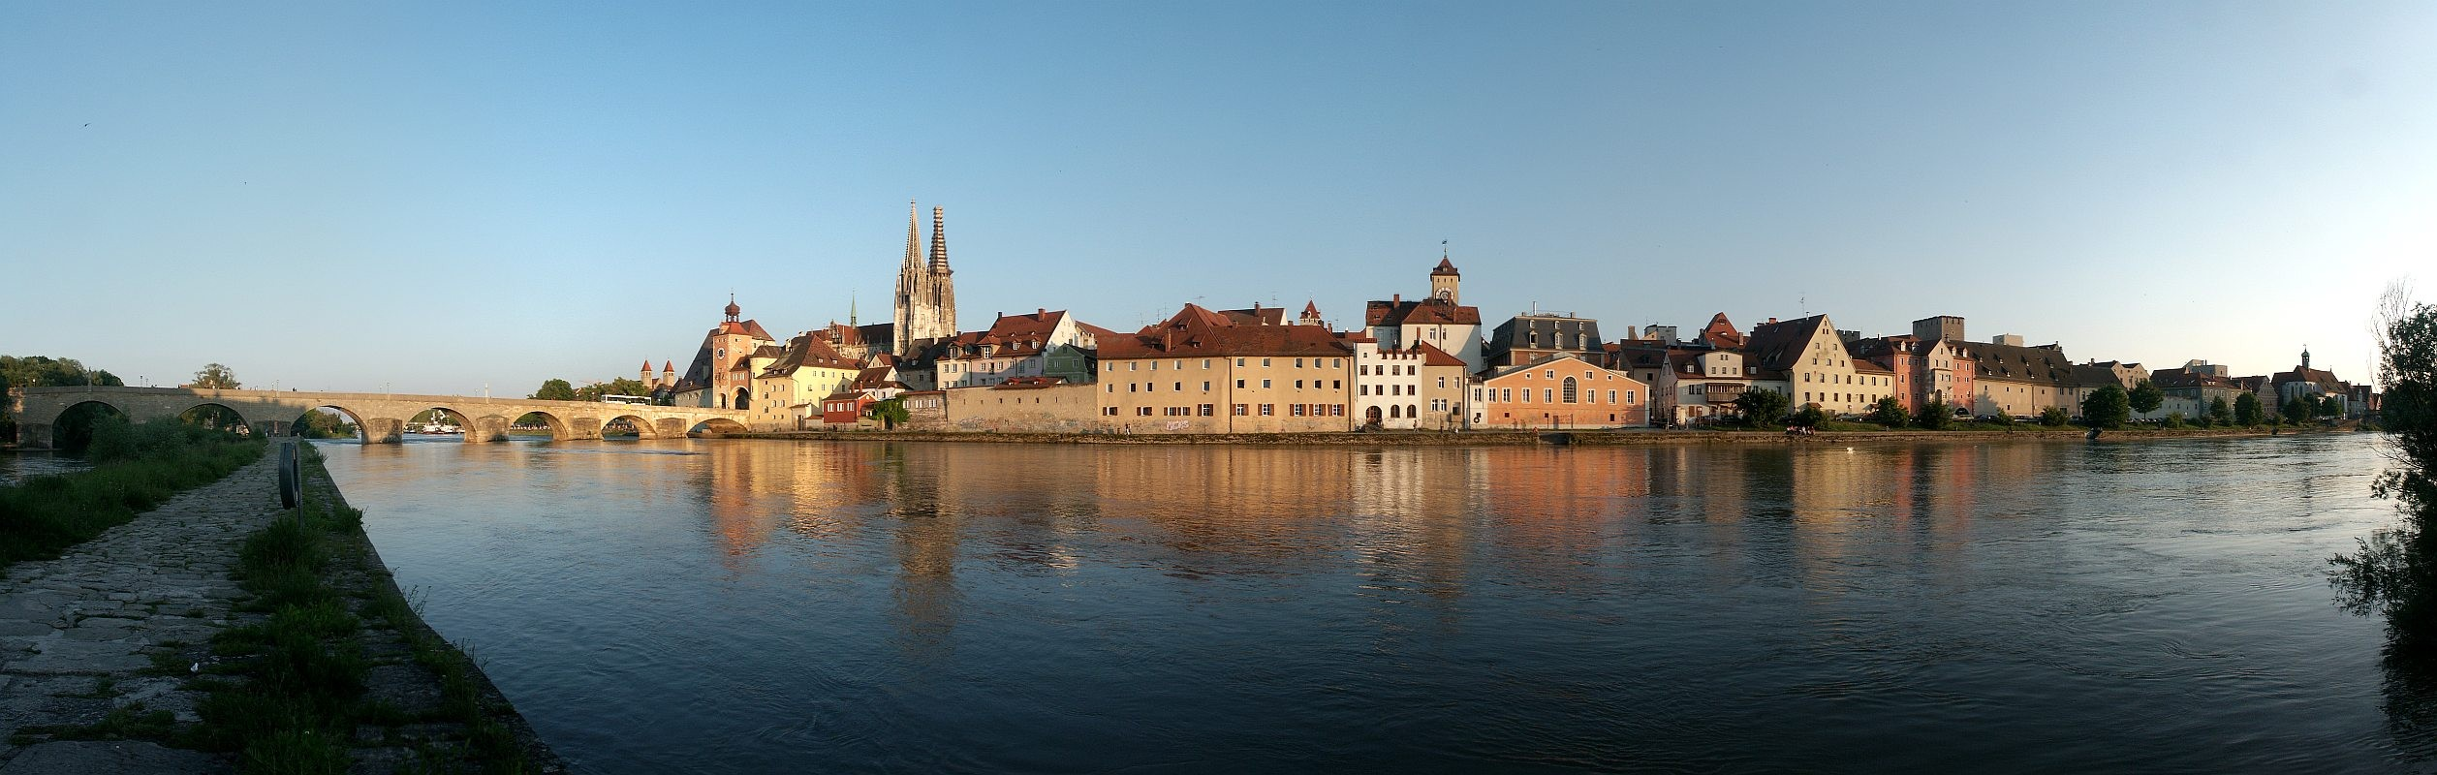
“On the way to Oaxaca” Workshop
UNESCO World Heritage Site
„Old Town of Regensburg with Stadtamhof”
The Management Plan Project
Matthias Ripp
World Heritage Coordinator
Cordoba – 05.06.2013

Slide 2
Contents
Regensburg World Heritage Site
Management Plan project
HerO project
Outcomes of the experience

Slide 3
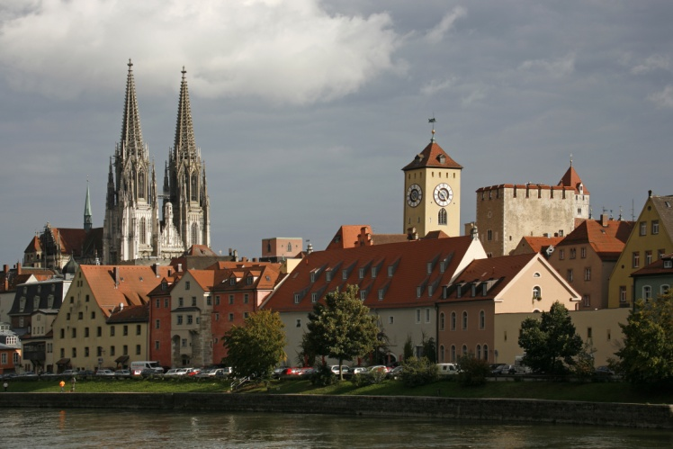
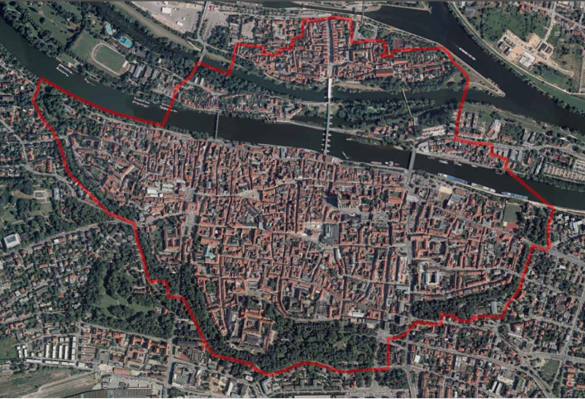
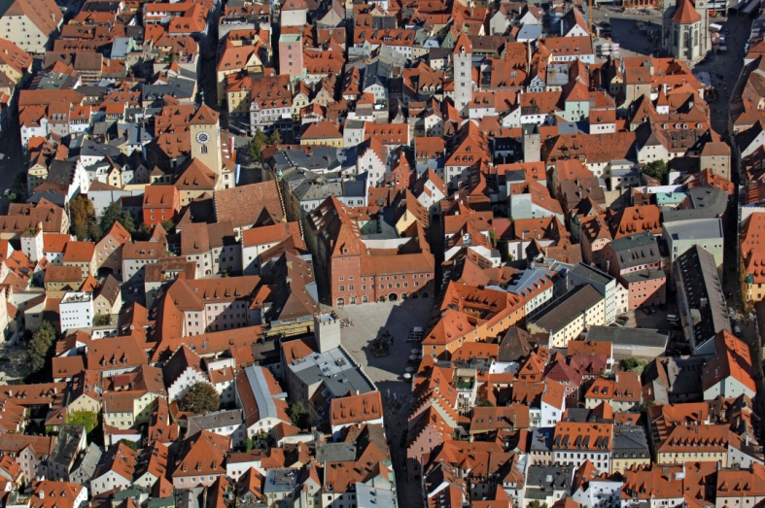
2000 year-old
town
Inscription
in 2006
Site of
183 hectares
1,000 architectural monuments

Slide 4
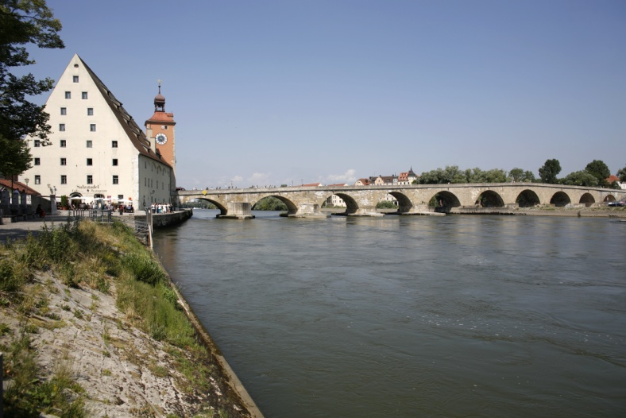
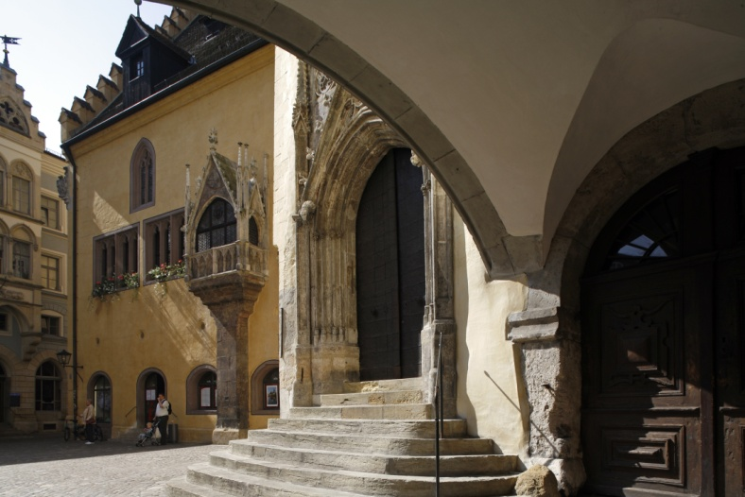
The only authentically
preserved medieval town
in Germany
Medieval centre
of trade
Centre of European
political power

Slide 5
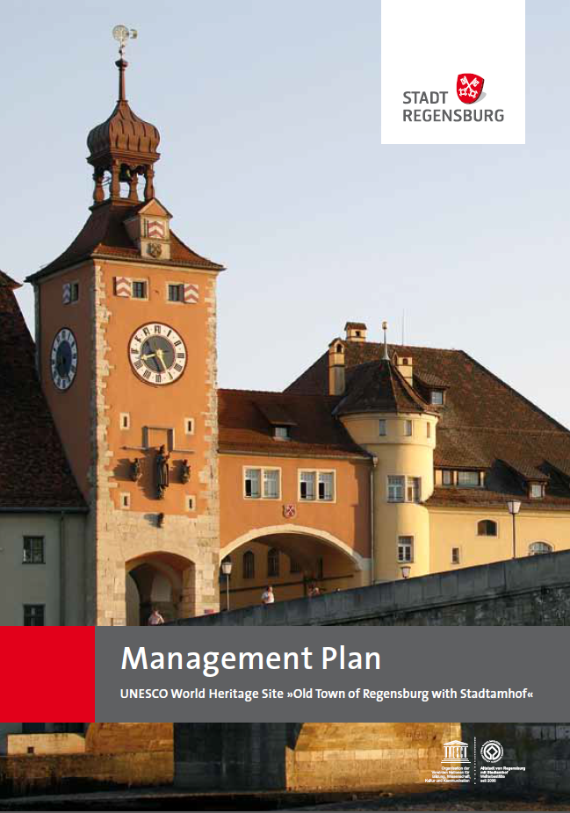
Fundamental
basis
“§108. Each nominated property should have an appropriate management plan or other documented management system which should specify how the outstanding universal value of a property should be preserved, preferably through participatory means.“
Operational Guidelines for the Implementation
of the World Heritage Convention

Slide 6
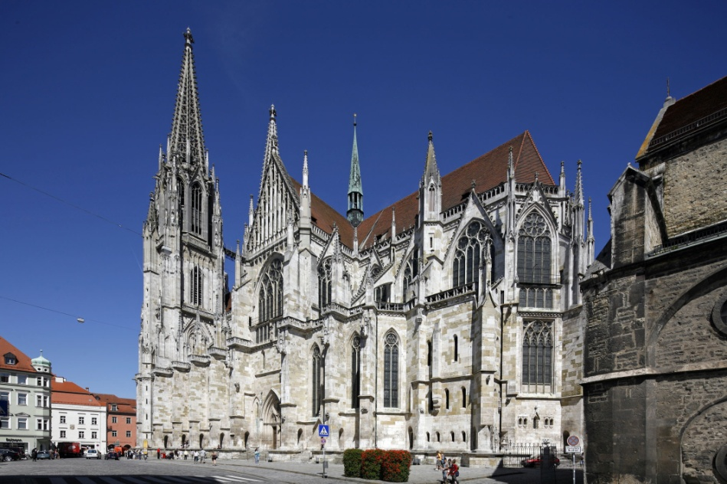
To keep a balance between preservation and development

Slide 7
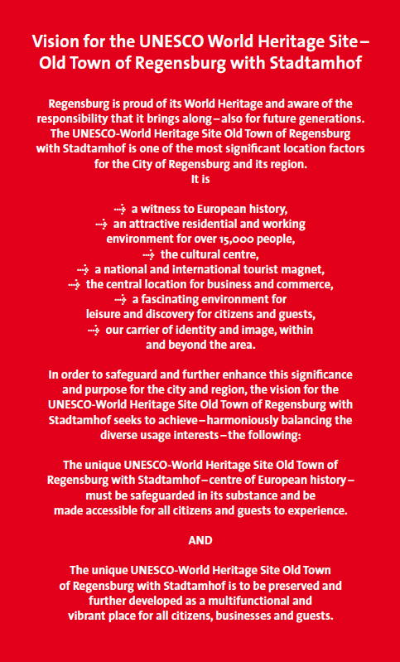
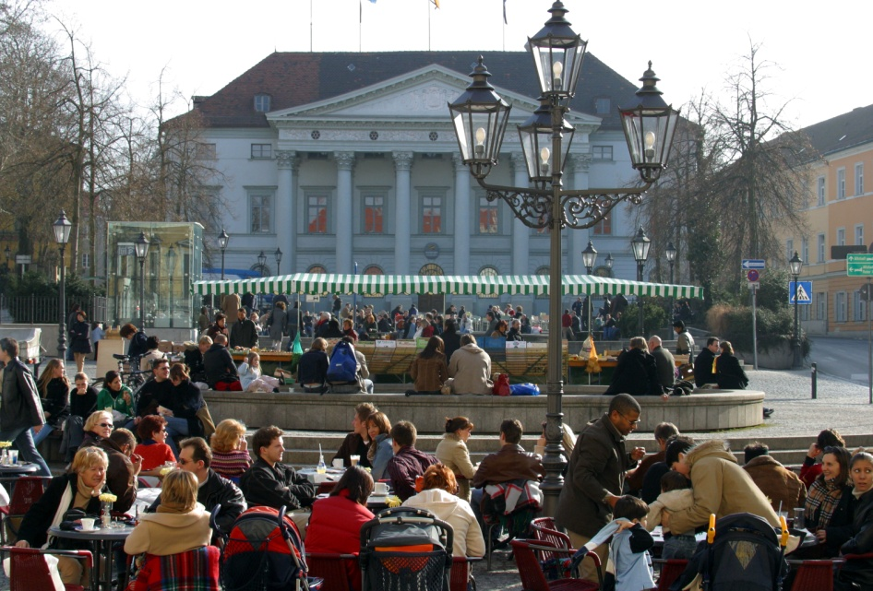
Preservation of the
cultural assets
Promotion of the
city’s vibrancy

Slide 8
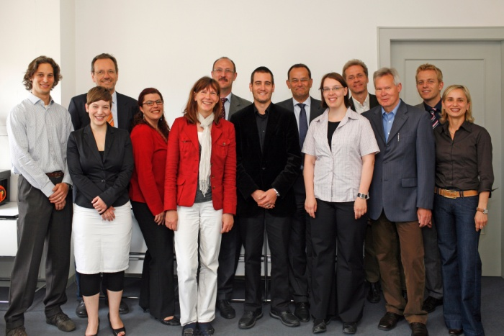
A range of actors

Slide 9
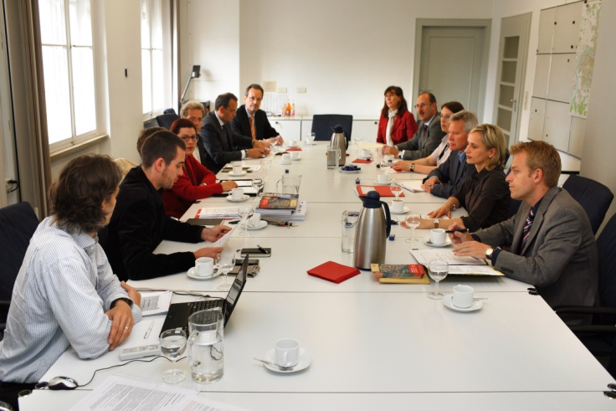
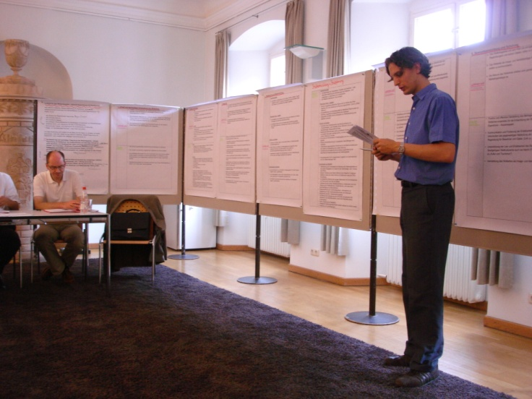
Management Plan
Work Group
• Aktionsgemeinschaft Altstadt e. V.,
• The Records and Conservation Office,
• Office for Urban Development,
• Office of Business Development,
• Building Office,
• Bavarian State Conservation Office,
• Bavarian State for Business, Infrastructure, Transport and Technology,
• Main Press and Public Relations Dept.,
• IHK Regensburg (Chamber of Trade and Industry),
• Cultural Office,
• Oberste Baubehörde im Bayerischen Staatsministerium des Innern (State Building Authority, Bavarian Ministry of the Interior),
• Environment and Legal Office,
• Regensburg Tourismus GmbH,
• Oberpfalz Government
• Stadtmarketing Regensburg (City Marketing Assoc.),
• Stadtplanungsamt (City Planning Office),
• Welterbe Kulturfonds Regensburg – die Förderer e. V.,
• World Heritage co-ordination committee and
• One male and one female representative from among
the inhabitants.

Slide 10
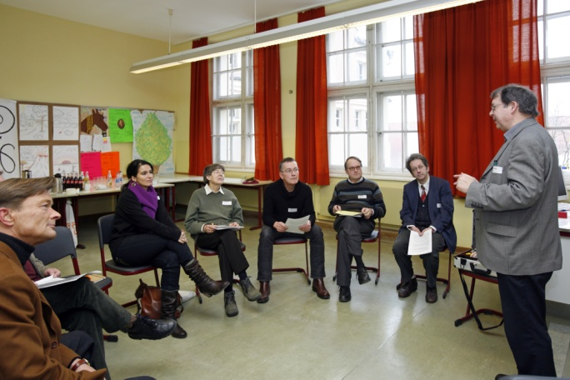
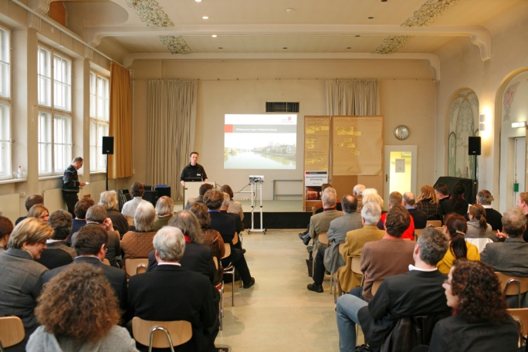
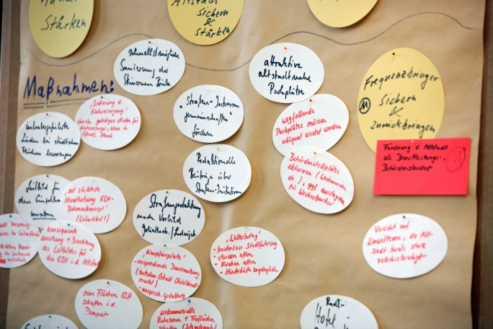
World
Heritage
Dialogue

Slide 11
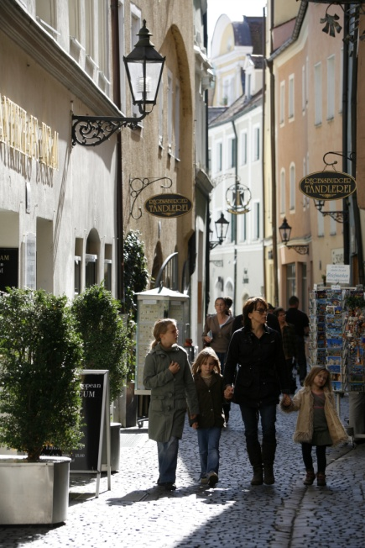
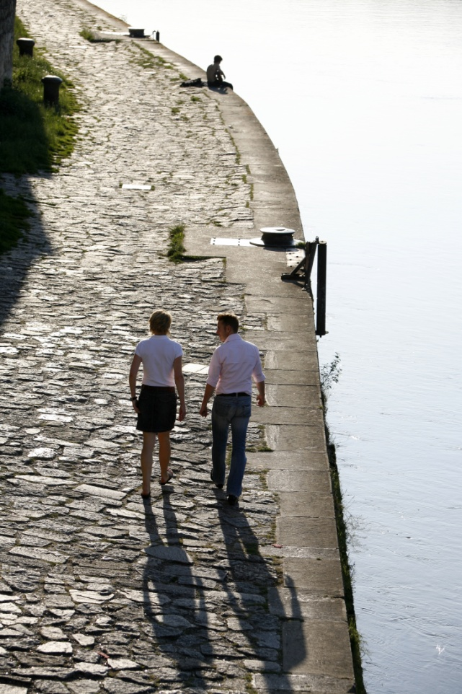
Needs of the
inhabitants
identified

Slide 12
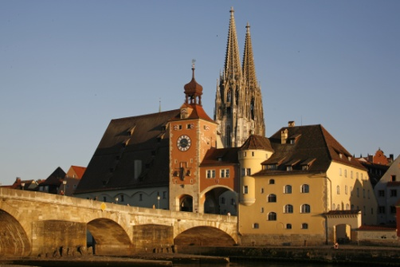
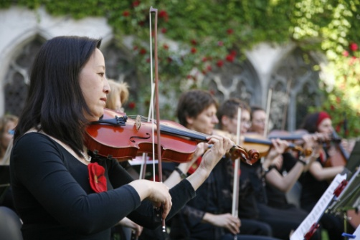
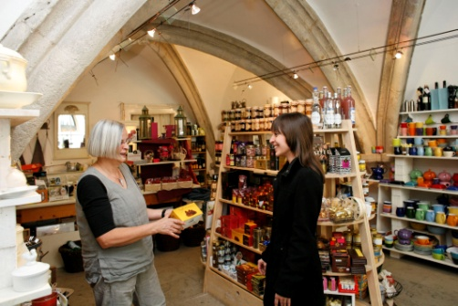
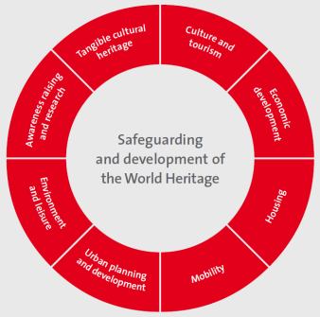
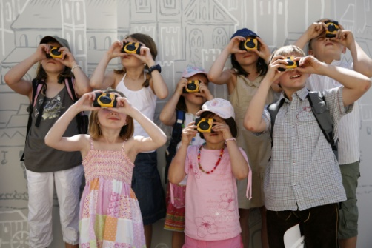
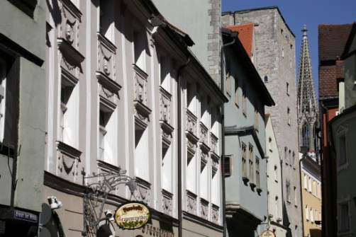
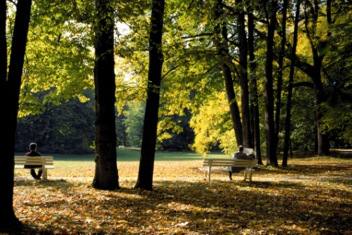
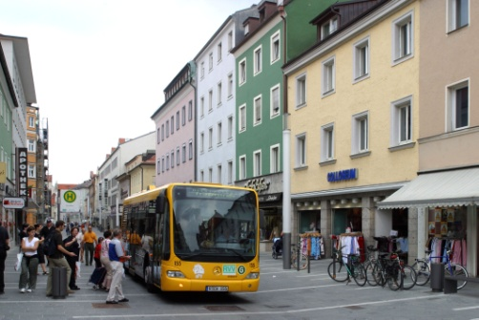

Slide 13
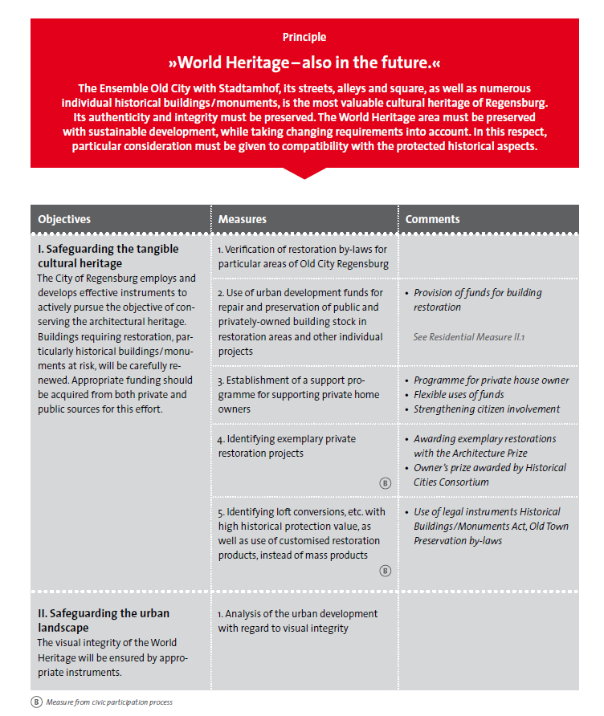
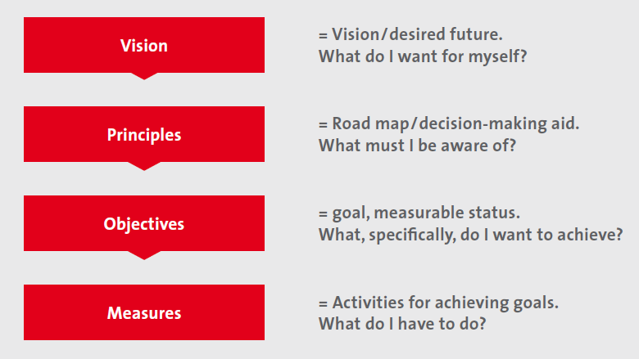
Field of action – Tangible cultural heritage
→

Slide 14
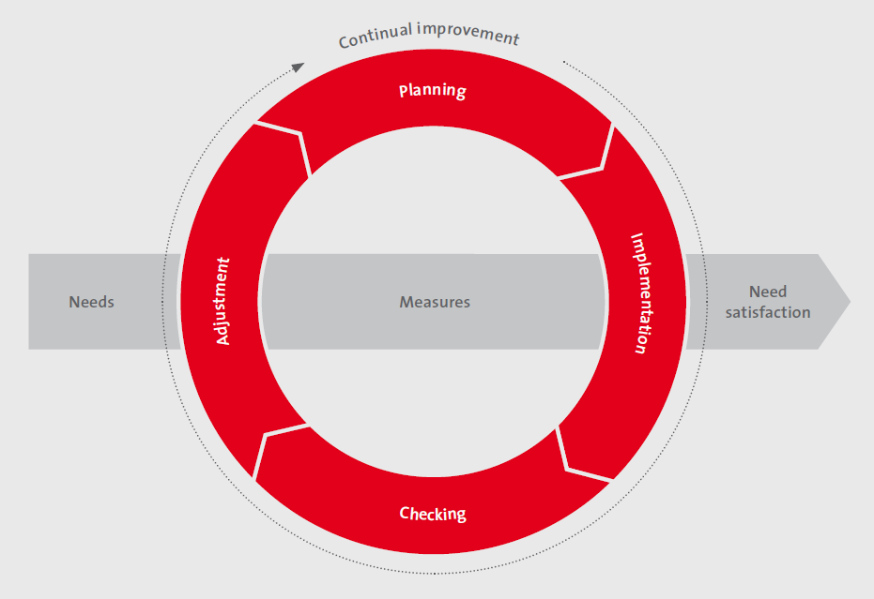
Management
system

Slide 15
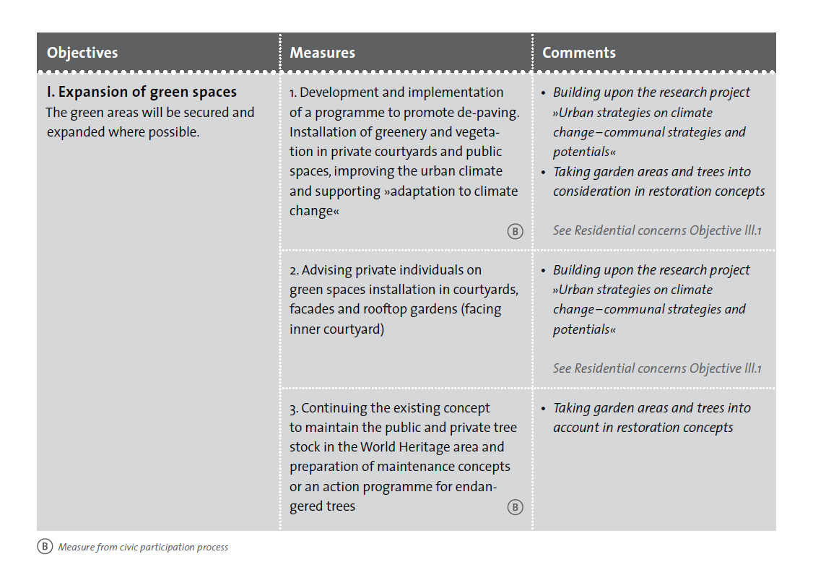
Implementation
Field of action – Environment and leisure

Slide 16
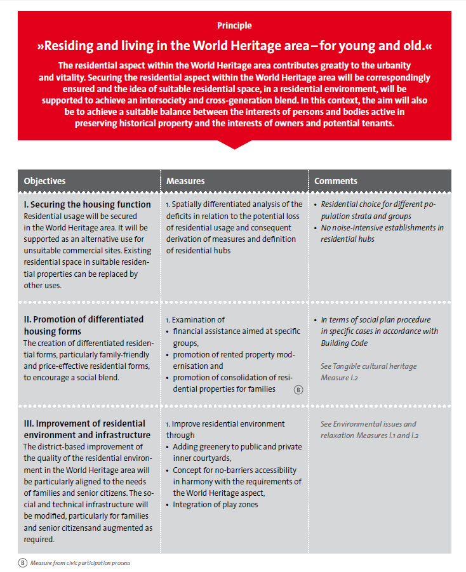
Harmony between the heritage,
the living city and the inhabitants
Field of action – Housing

Slide 17
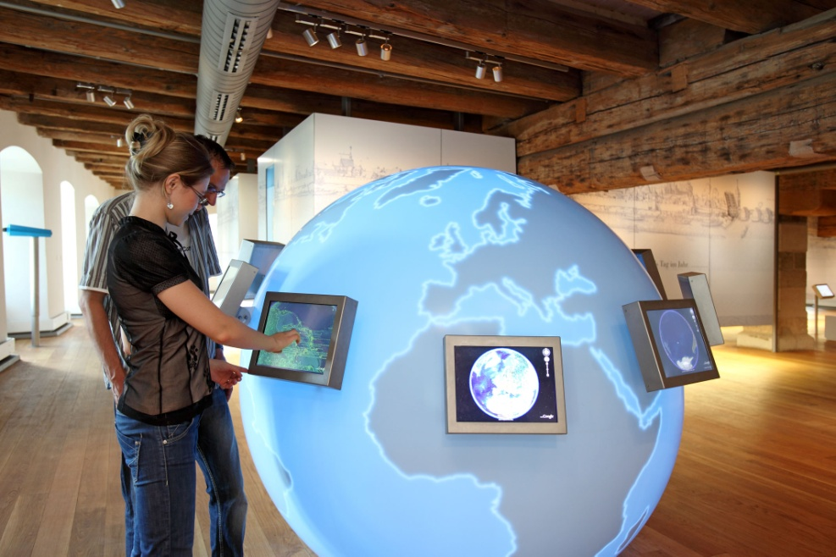
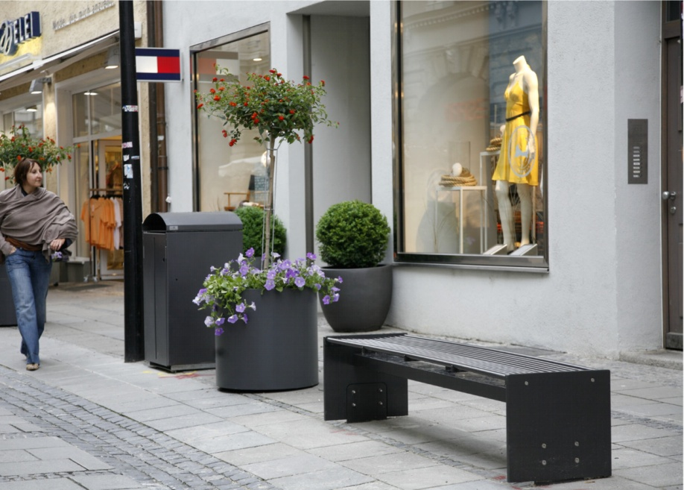
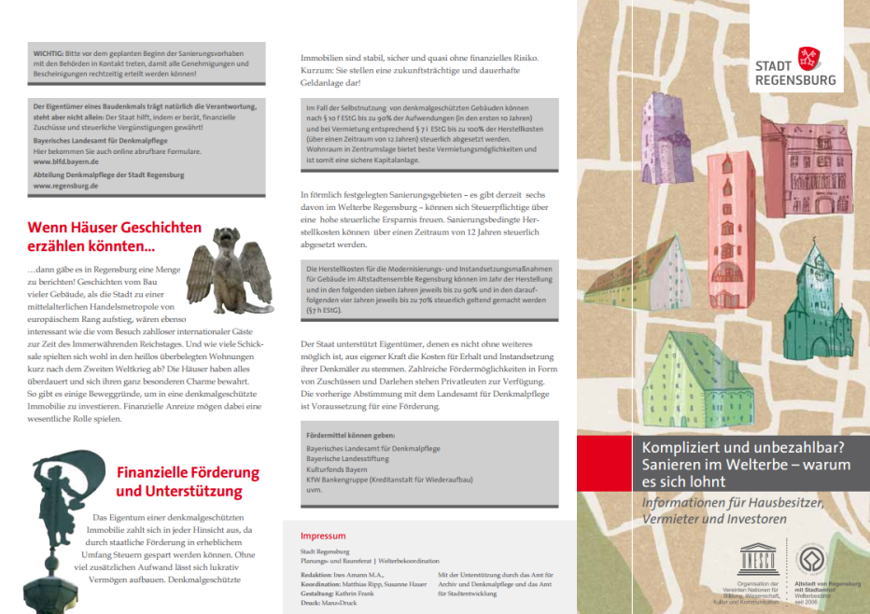
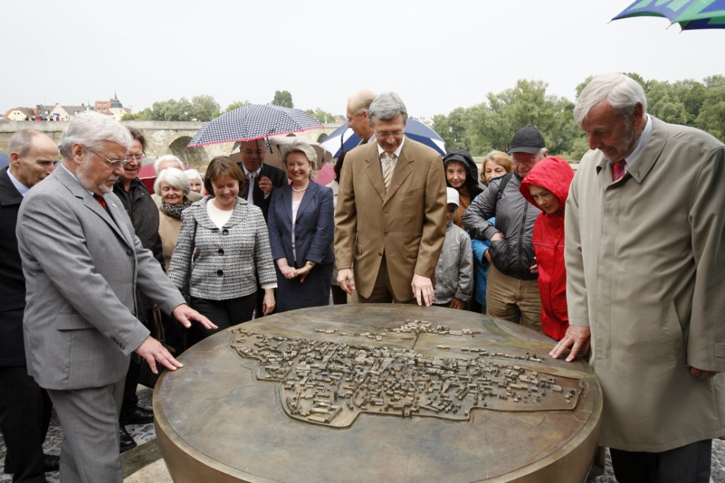
35% of the actions carried out in 1 year

Slide 18
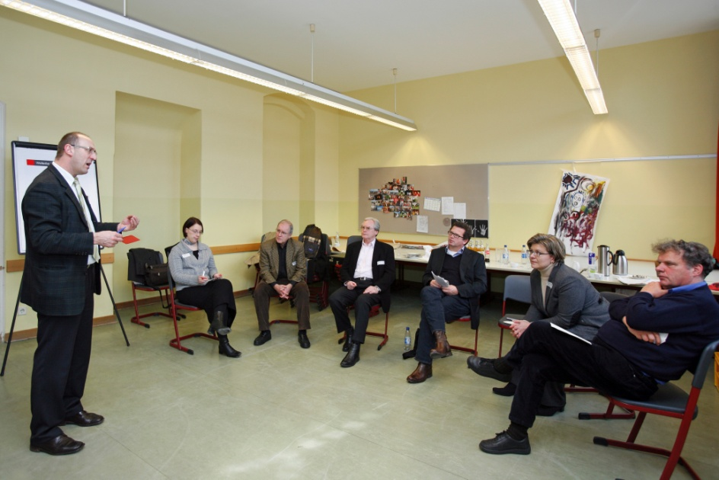
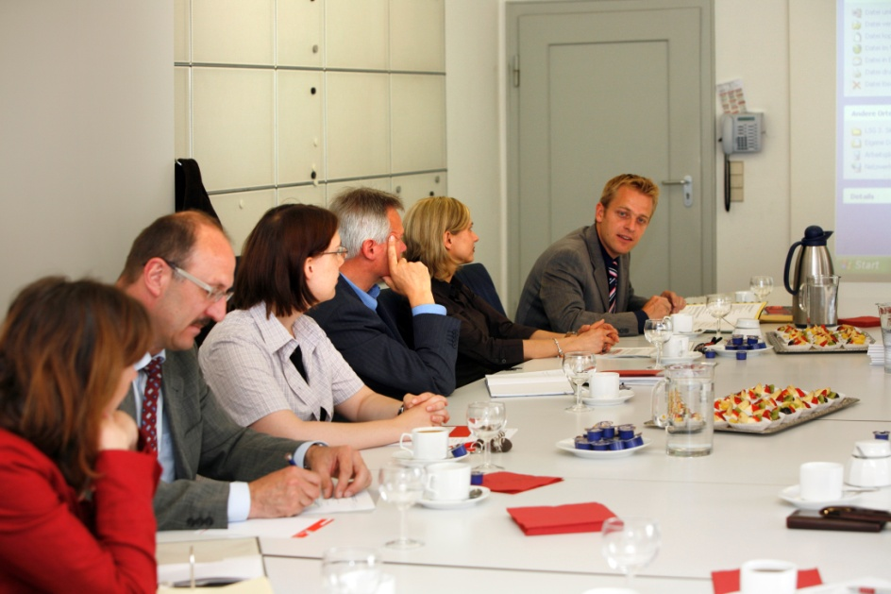
Success factors
1. Integrated approach

Slide 19
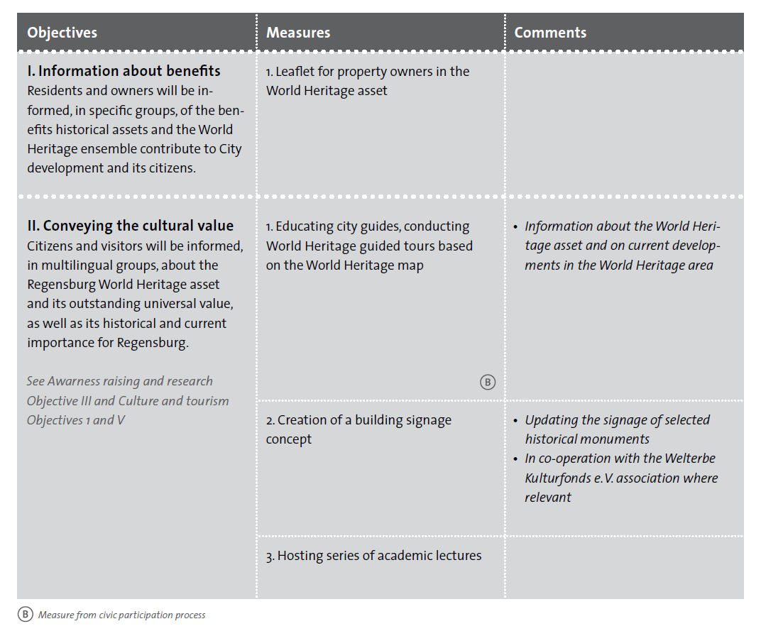
Success factors
2. Action-based orientation
Field of action – Awareness raising and research

Slide 20
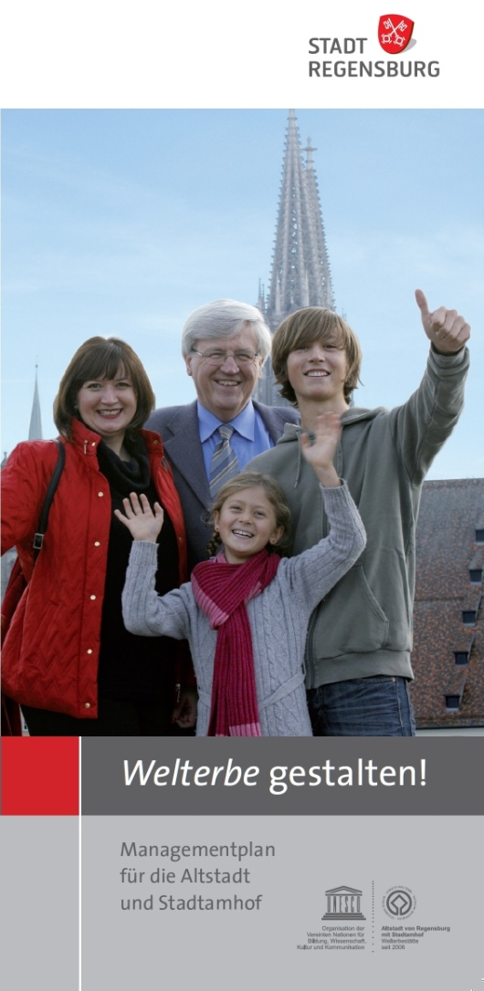
Success factors
3. Participatory
preparation
process

Slide 21
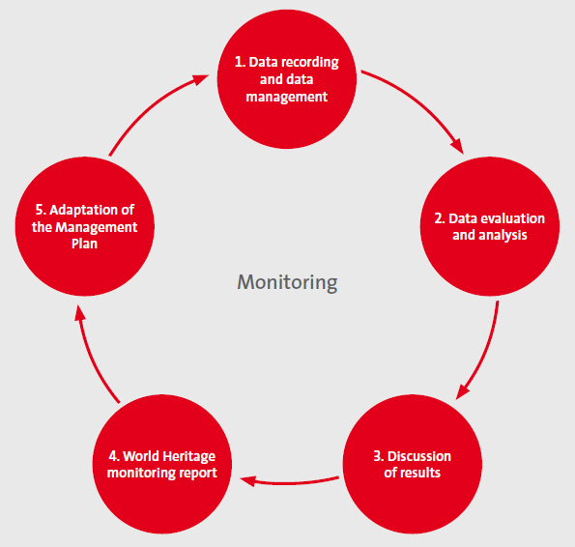
Success factors
4. Continual
improvement

Slide 22
Perspective of the Management Plan
↓
HerO Project
(Heritage as Opportunity)

Slide 23

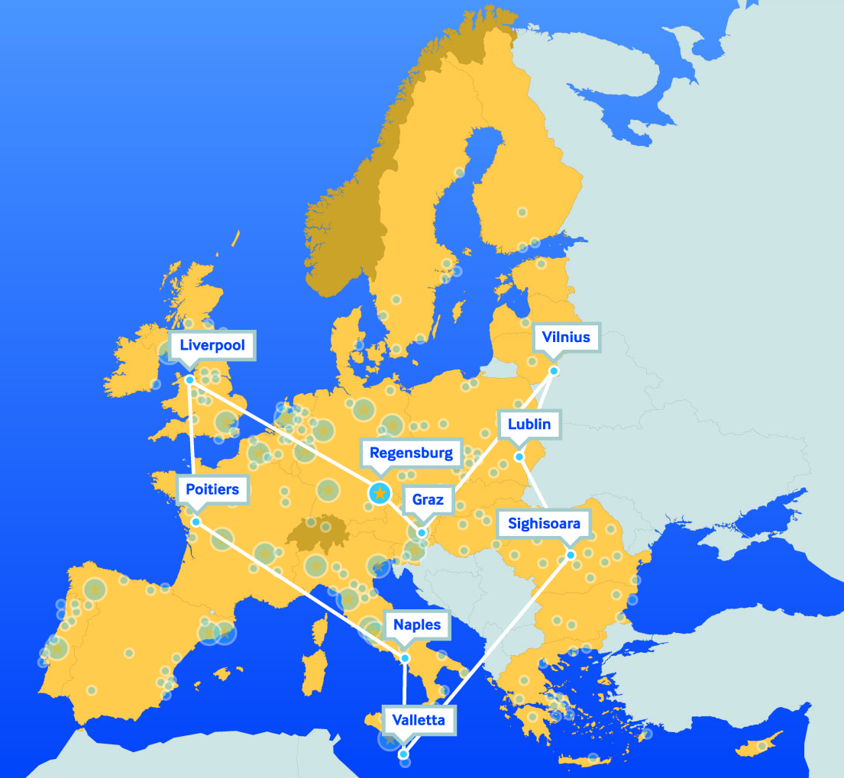

URBACT II Project
Network of 9 European cities
Historic urban landscapes
April 2008 – July 2011

Slide 24
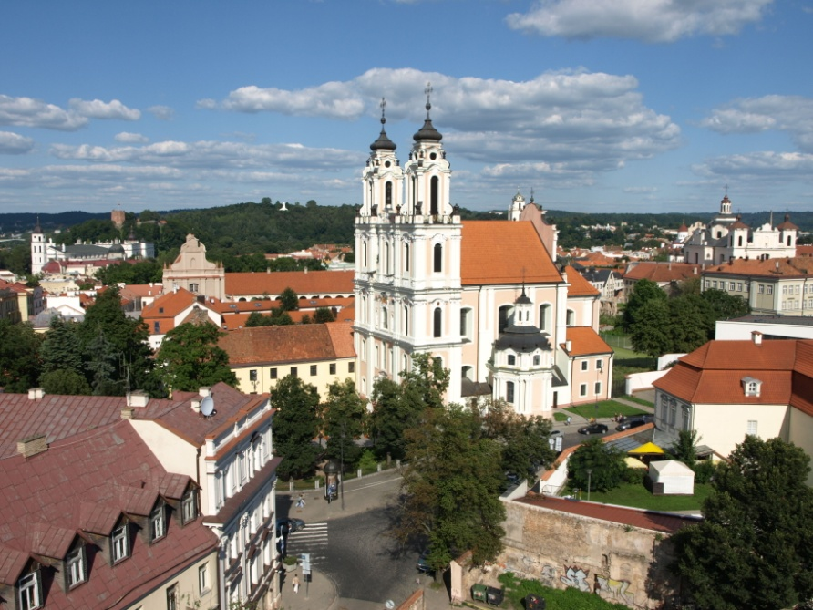
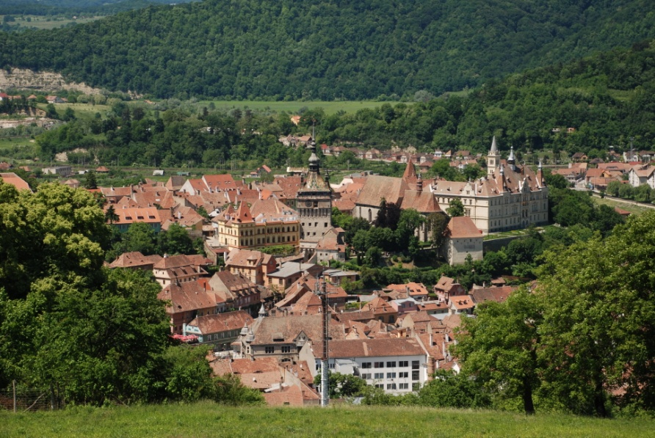
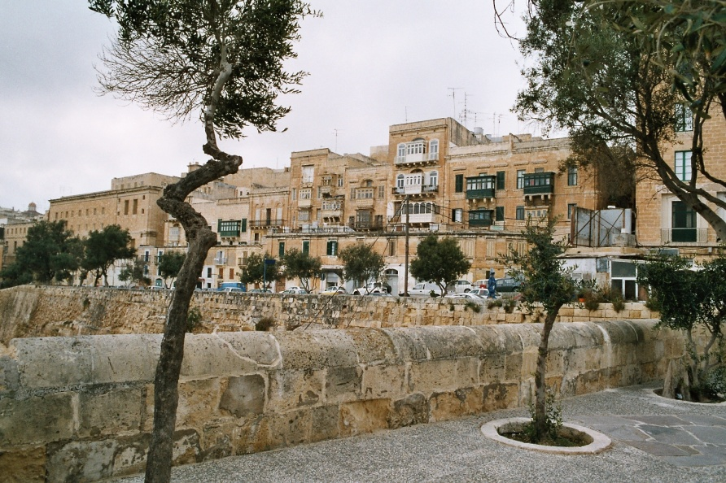
Vilnius (Lithuania)
To strengthen the attractiveness
and competitiveness
of historic towns
Sighişoara (Romania)
Valletta (Malta)

Slide 25
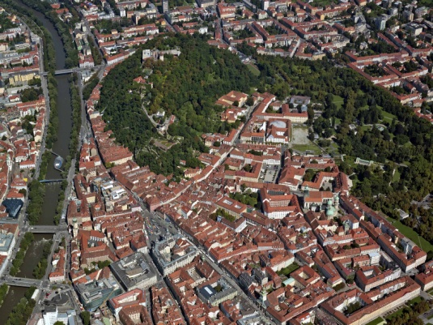

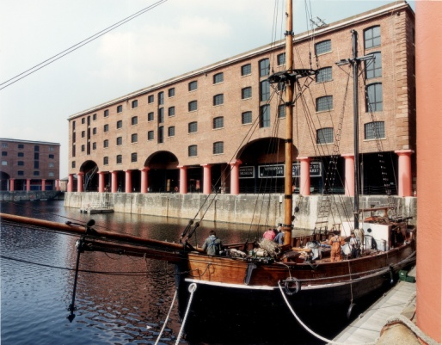
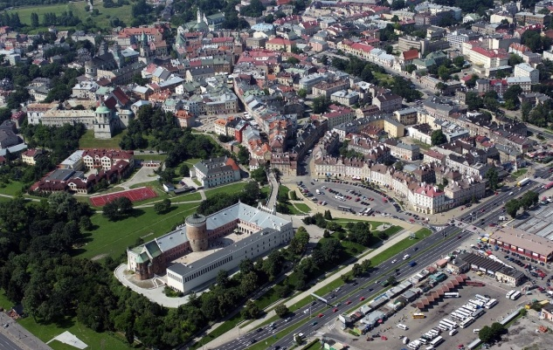
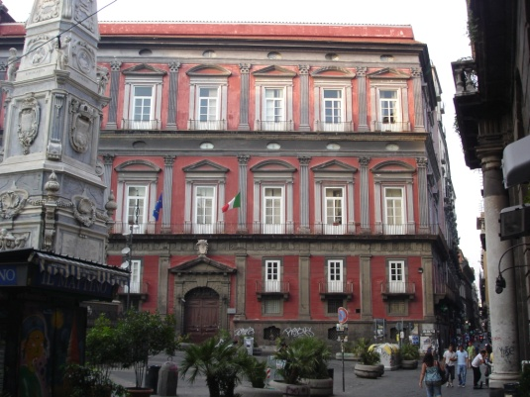
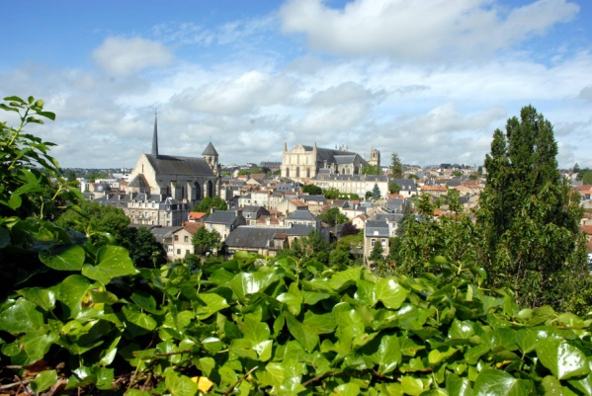
Visual
integrity
Graz
(Austria)
Regensburg (Germany)
Liverpool
(United Kingdom)
Lublin
(Poland)
Naples (Italy)
Poitiers (France)
Multifunctional
area

Slide 26






Slide 27

Guidebook
↓
Integrated and innovative
management strategies

Slide 28


Slide 29




To start a heritage-based development approach
Groundwork for using funding sources

Slide 30
A model methodology
→ tested in 9 European cities
→ used by 25 cities world-wide
→ Factors of success
* Integrated approach
* Action-based orientation
* Participatory preparation process
* Continual improvement

