Slide 1
ÉVORA´S
PUBLIC USE PLAN
On the Way to Oaxaca
Córdoba, June 4/6

Slide 2
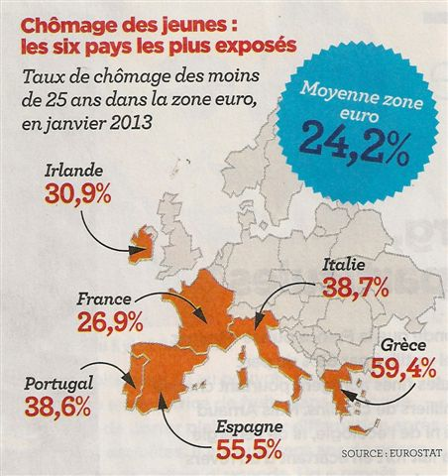
IN PORTUGAL:
Internal Product has dropped – 4,5%
Investment has dropped nearly 30%
Unemployment rate - 17,6%
Évora´s revenue decreases about 19%
1

Slide 3
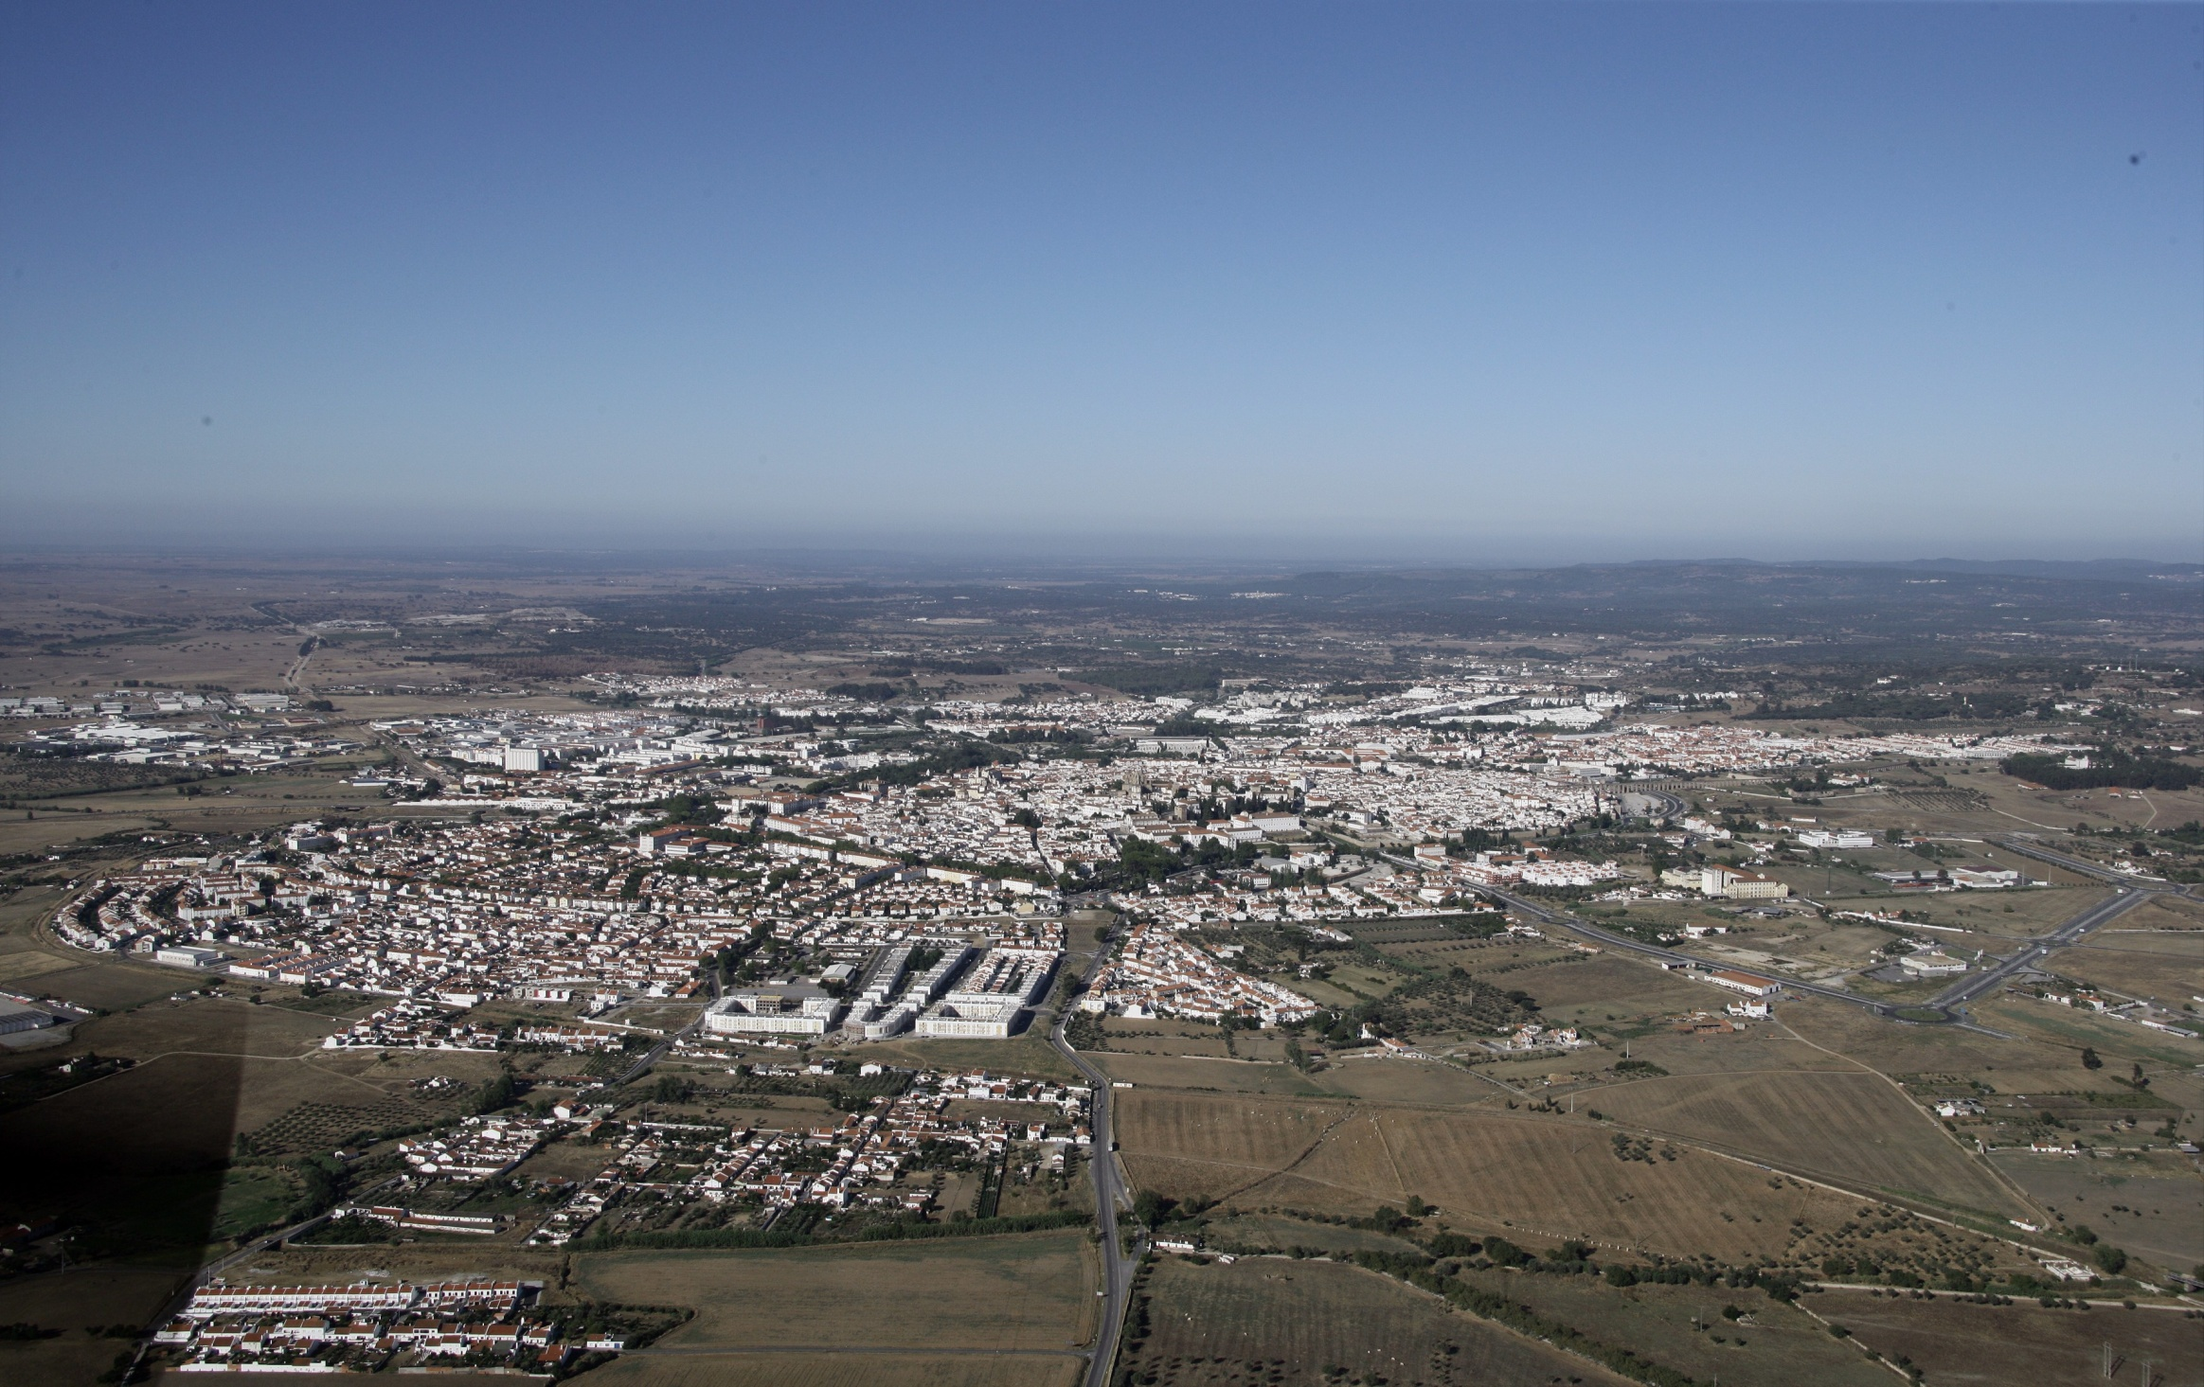
SHARING RESOURCES
Lack of a Plan
Lack of “working together”
Lack of common messages
2

Slide 4
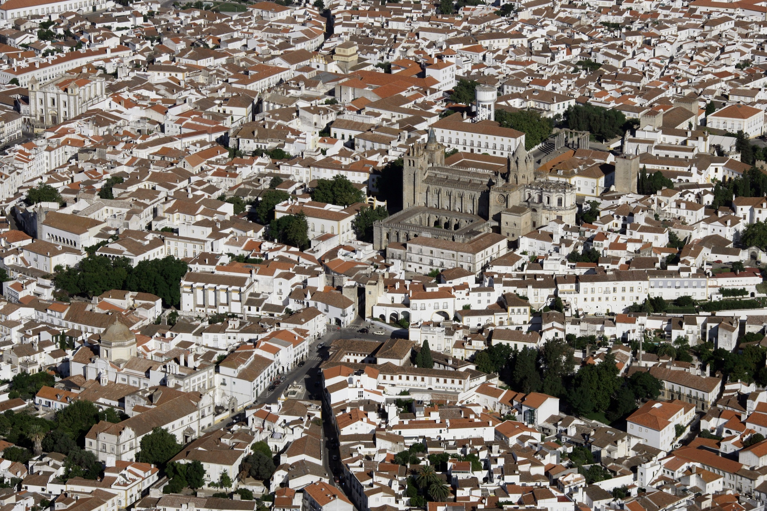
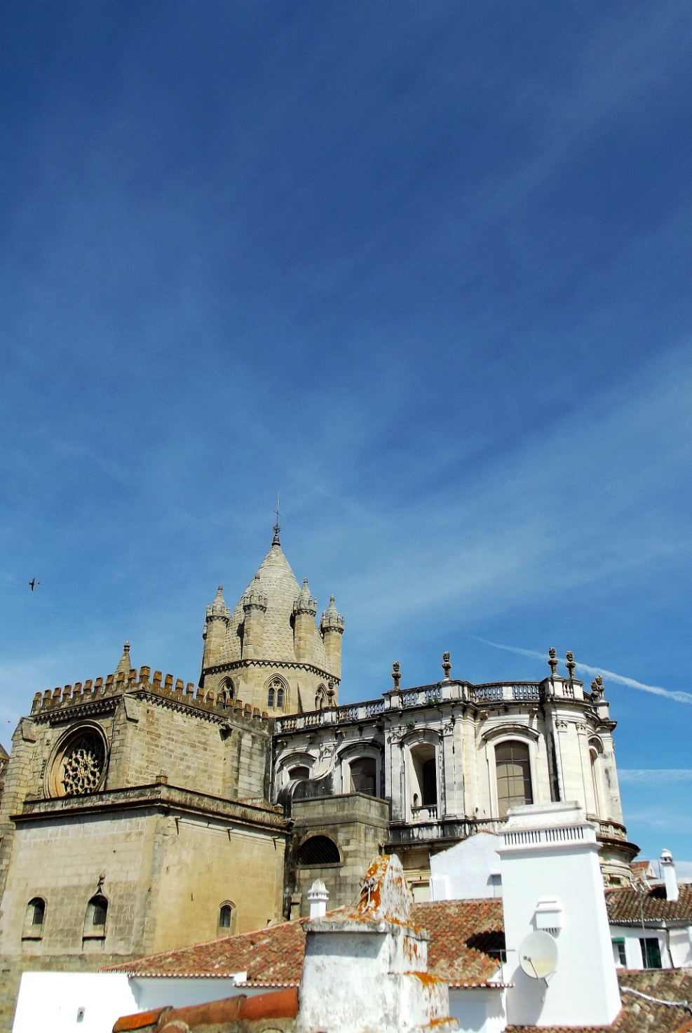
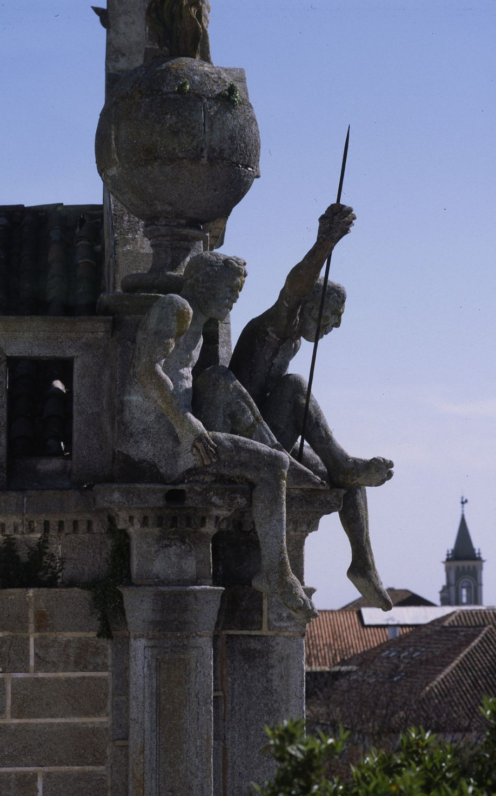
NEED FOR A NEW APPROACH
UNESCO and Turismo de Portugal offered a program that represented a new path forward: PUP
3

Slide 5
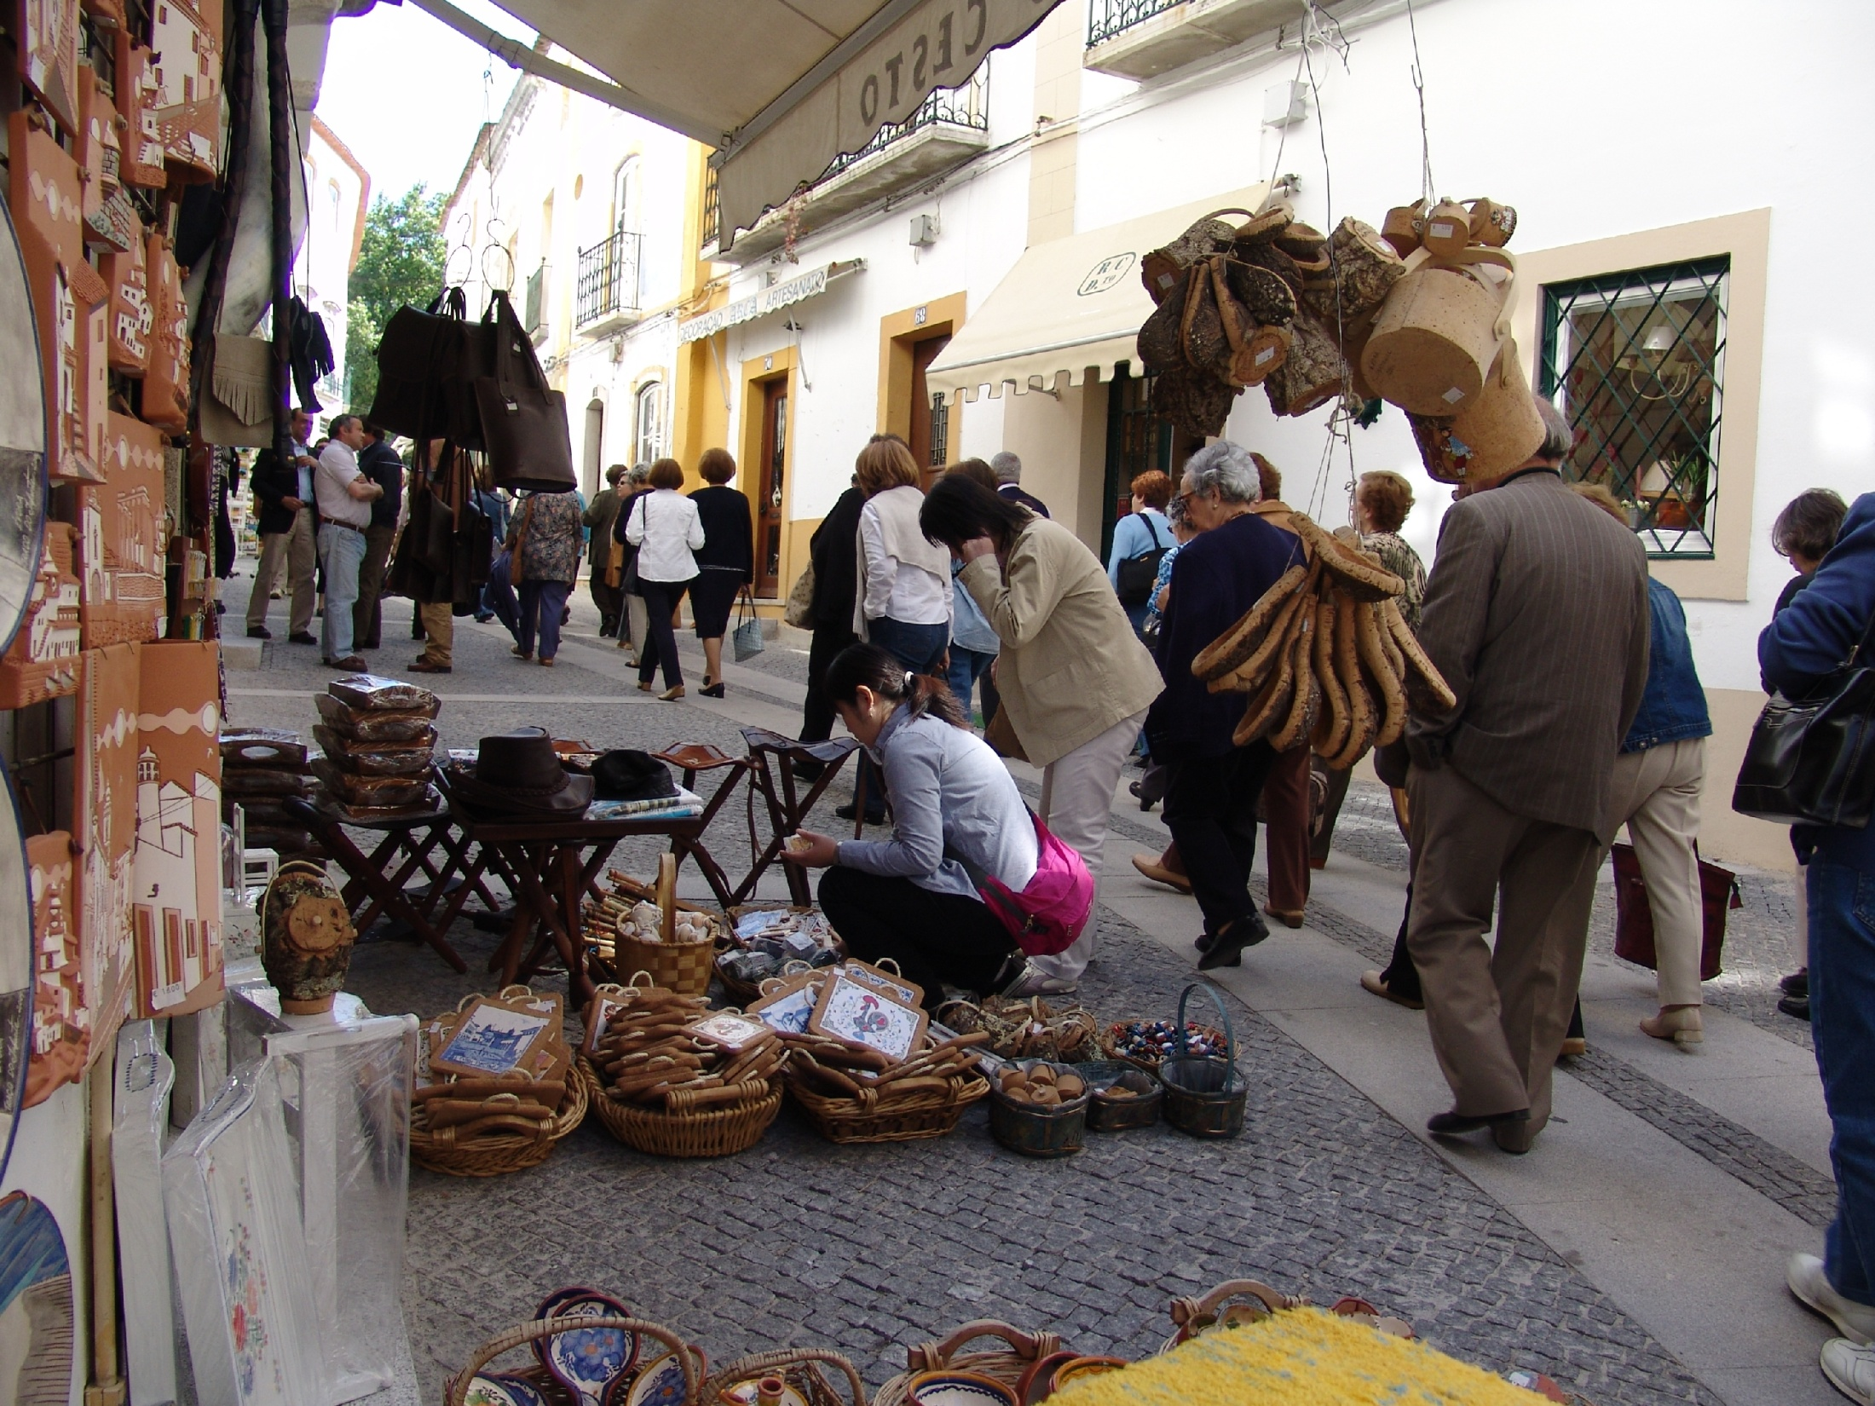
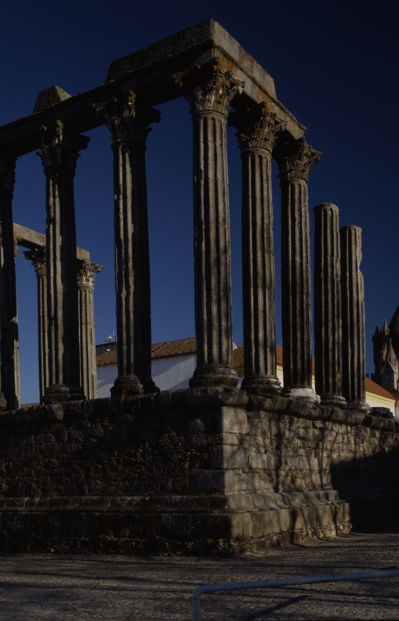
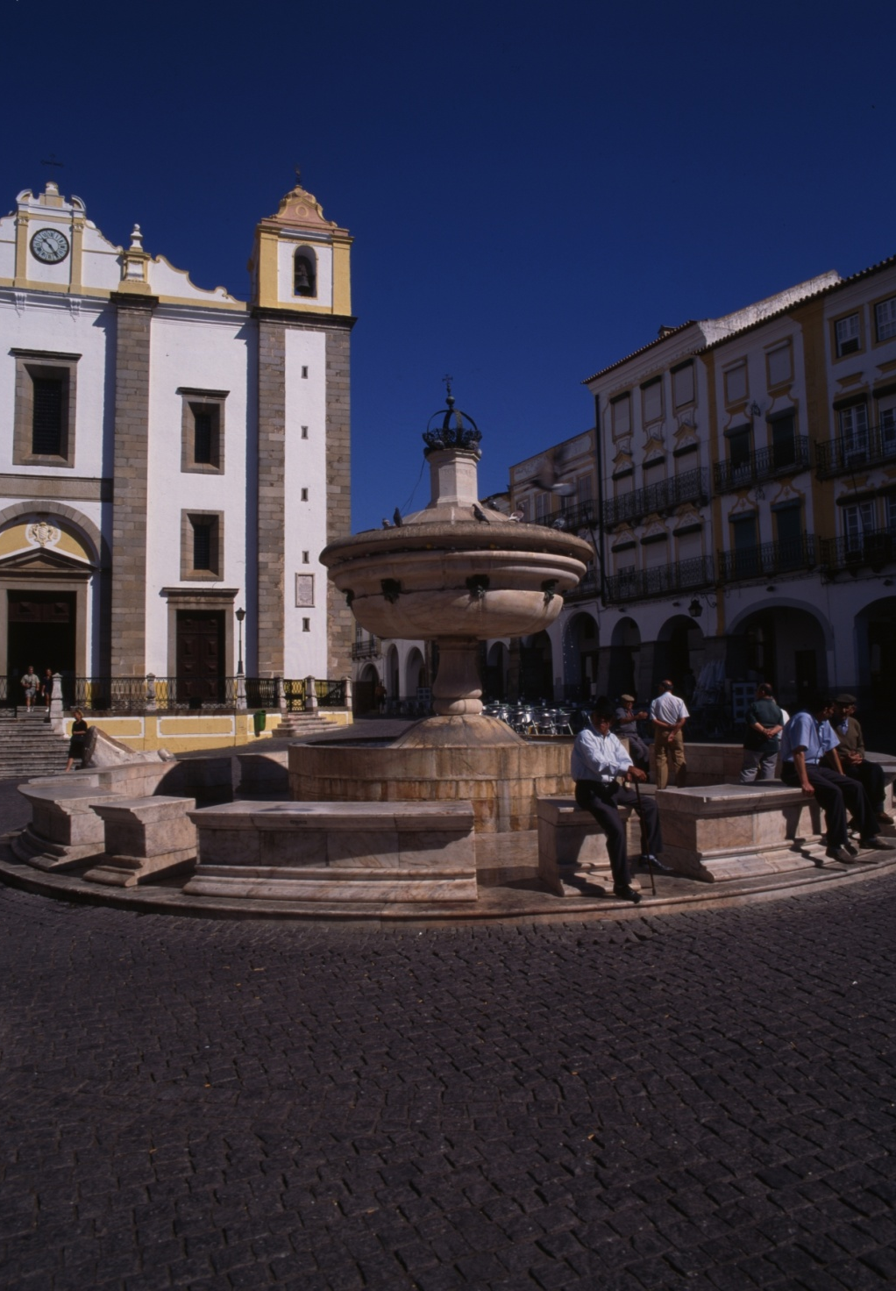
4

Slide 6
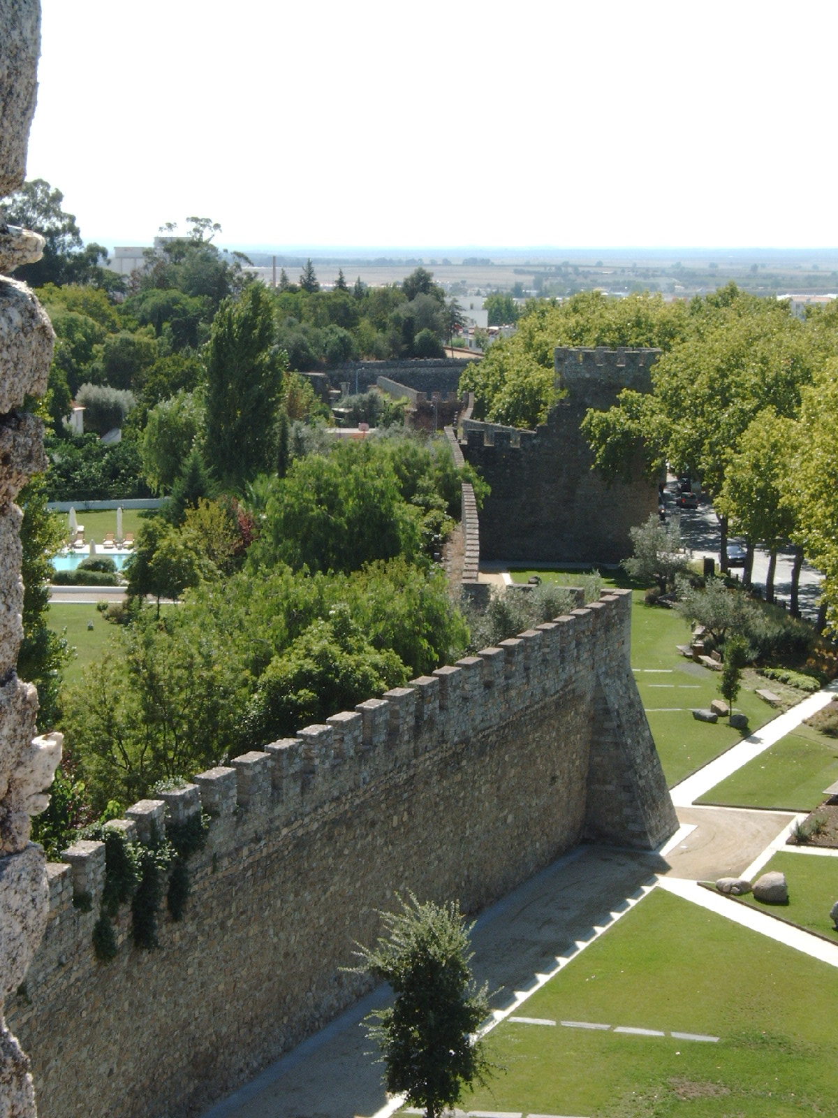
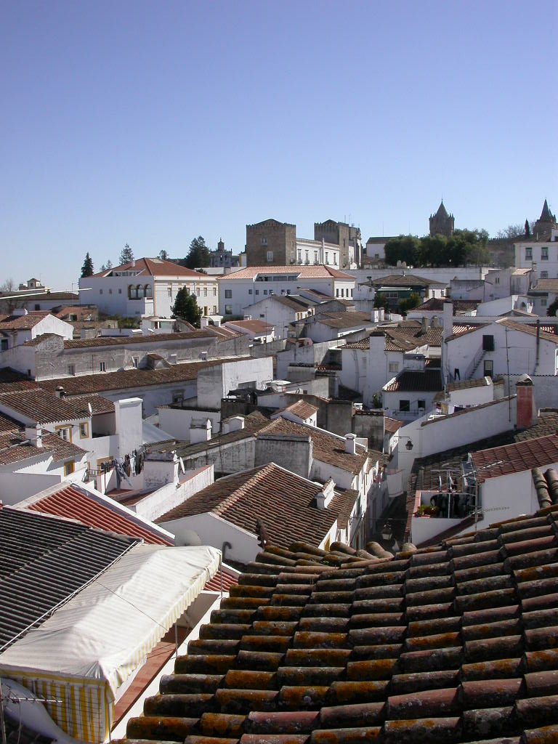
PLANNING
Traditional planning is bureaucratic, highly technical and based on stability which no longer works in a rapidly changing complex world.
5

Slide 7
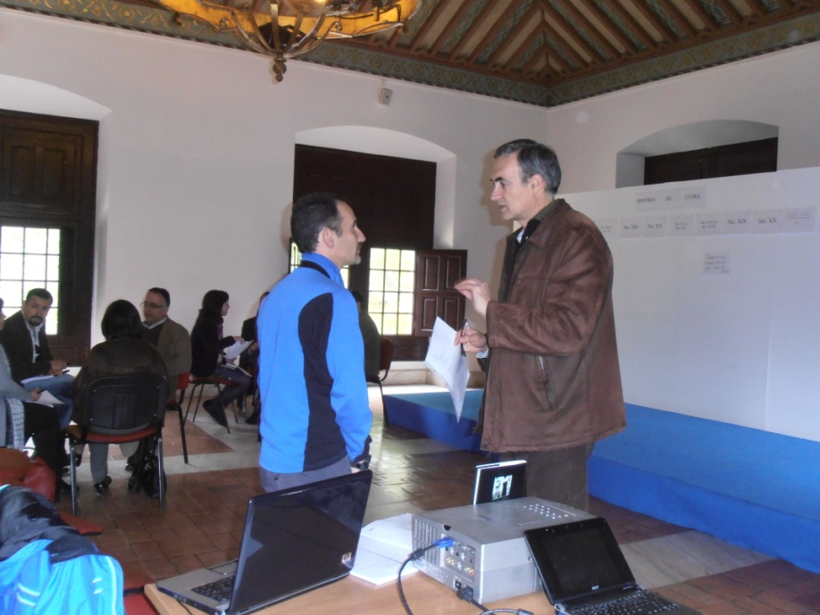
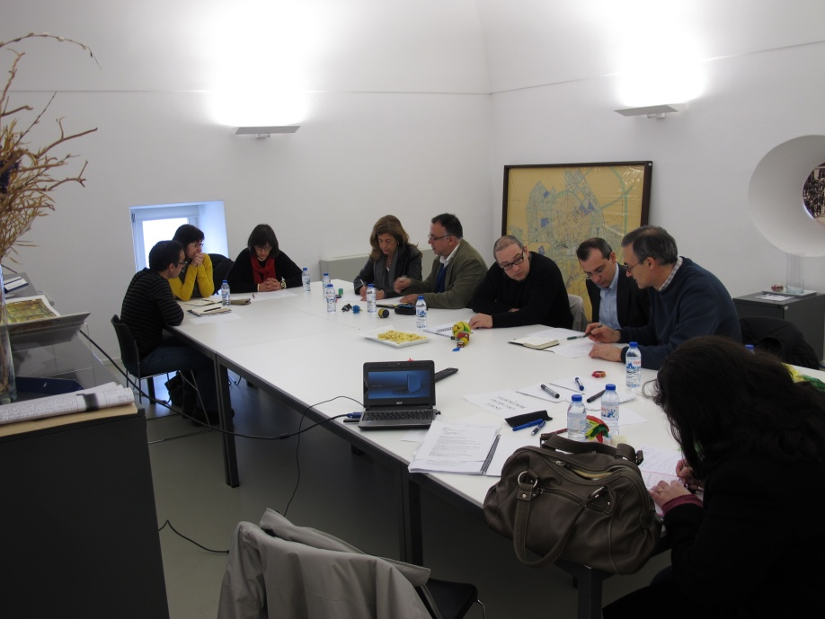
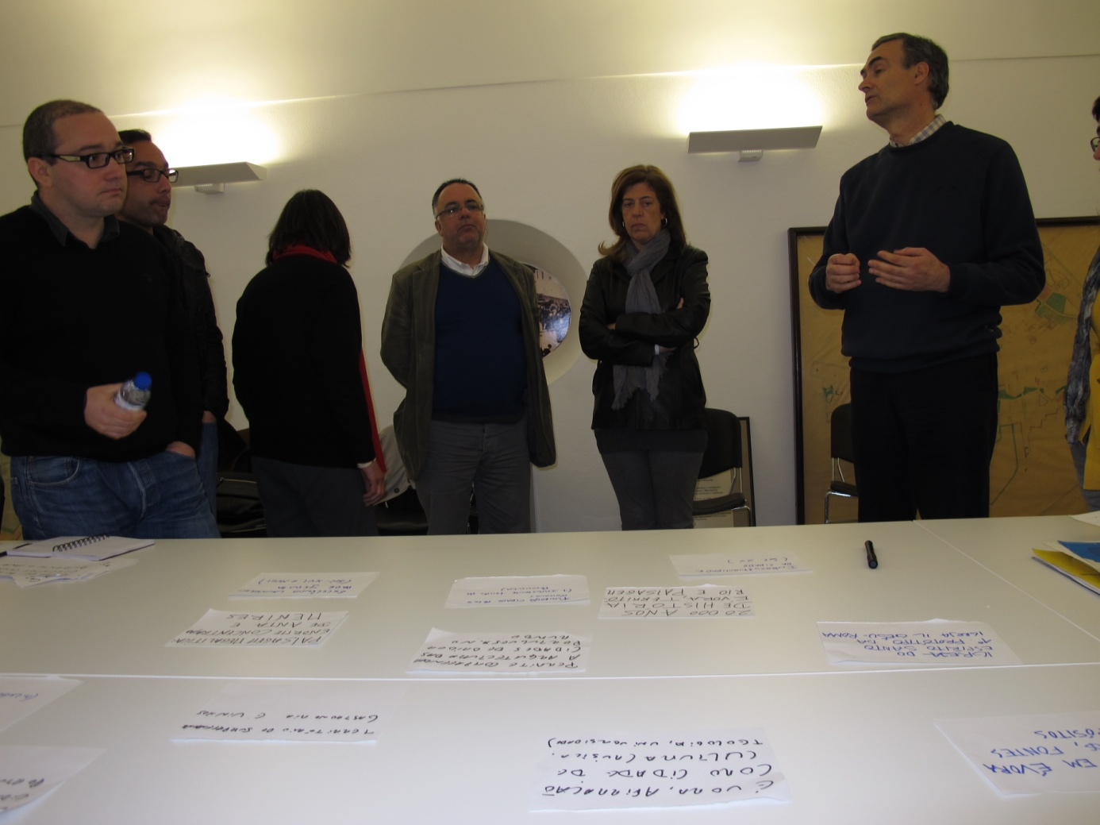
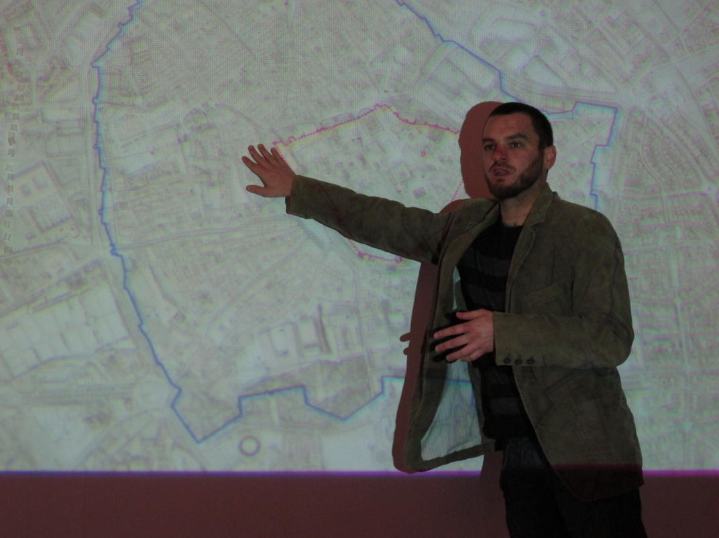
INTERNAL ORGANIZATION
Internal Working Team
Internal advisory Team
External advisory commission
6

Slide 8
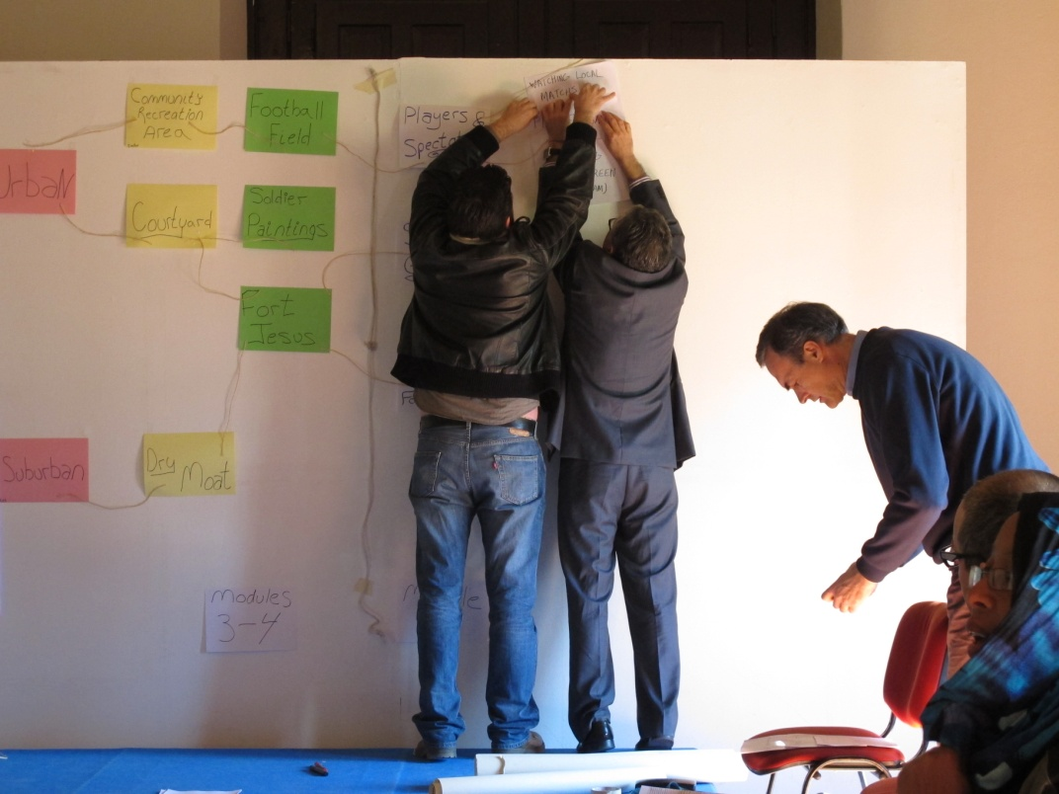
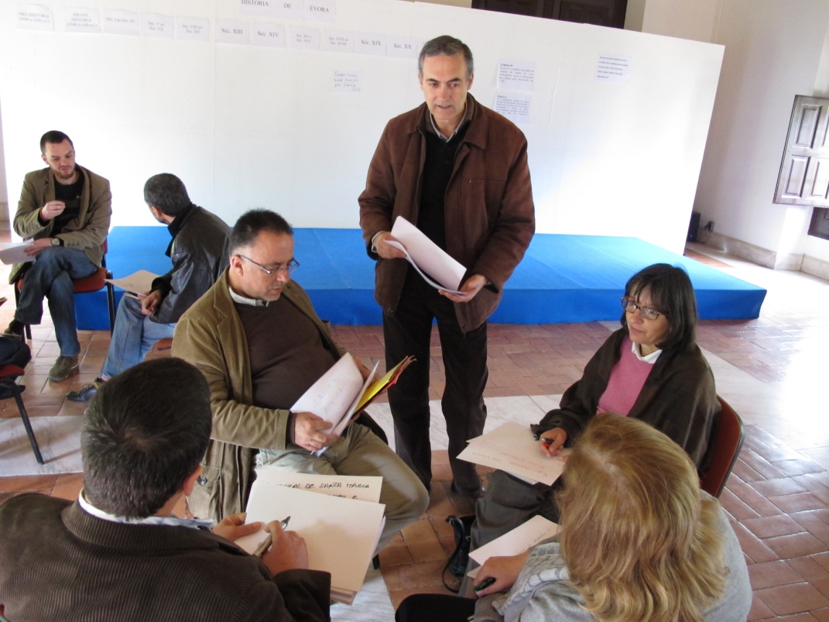
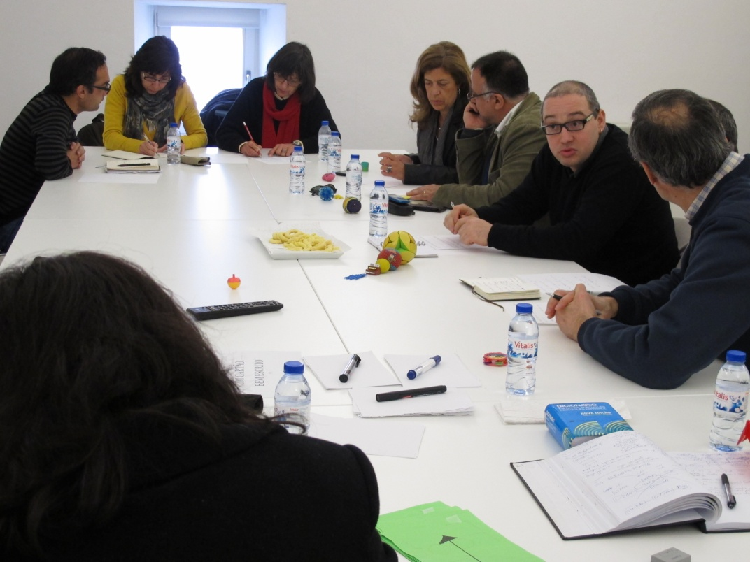
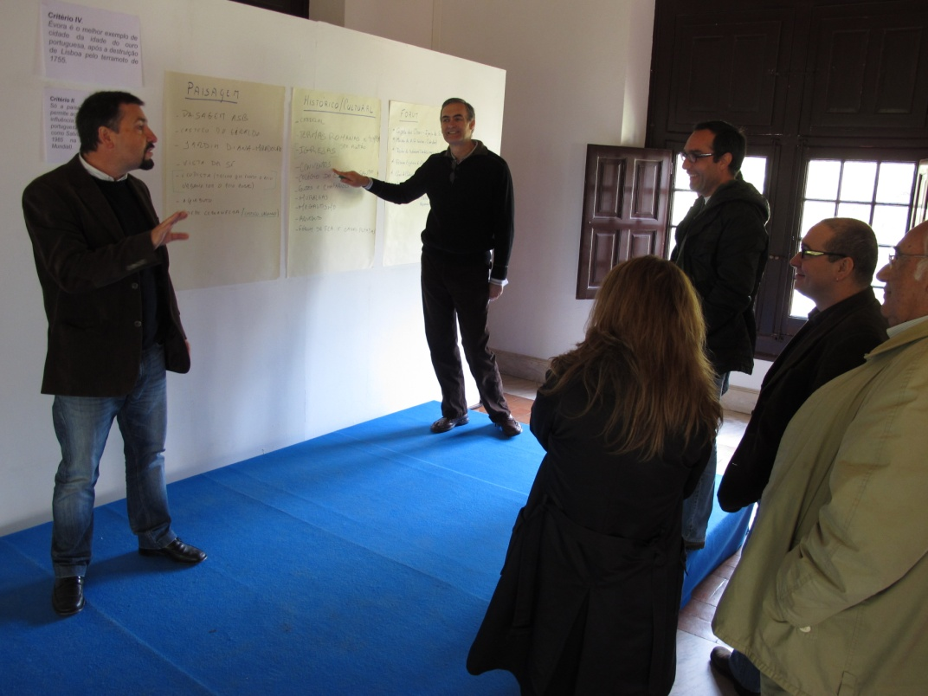
SHARING POWER
7

Slide 9
8

Slide 10
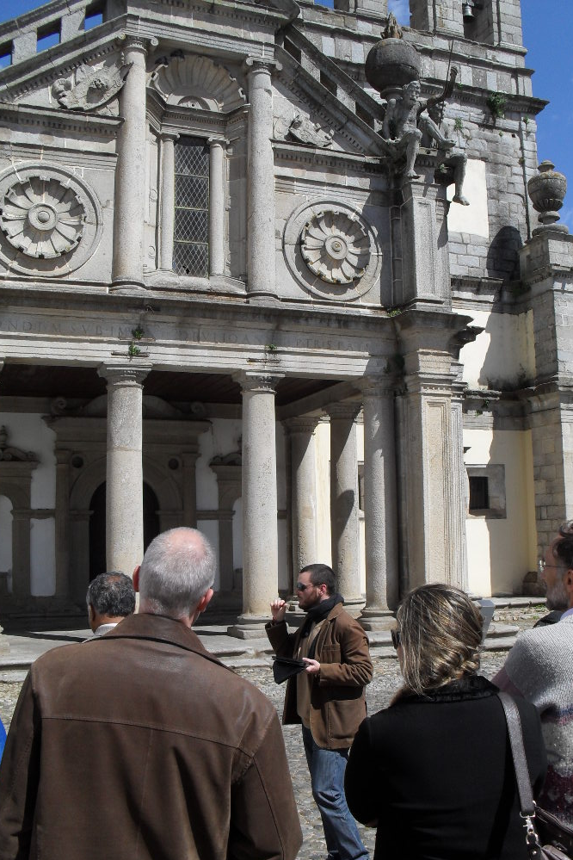
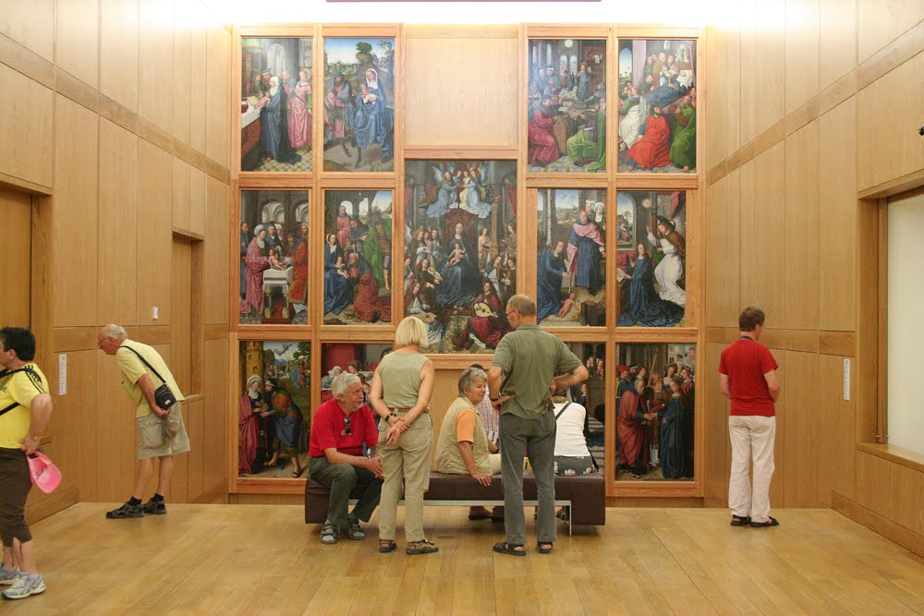
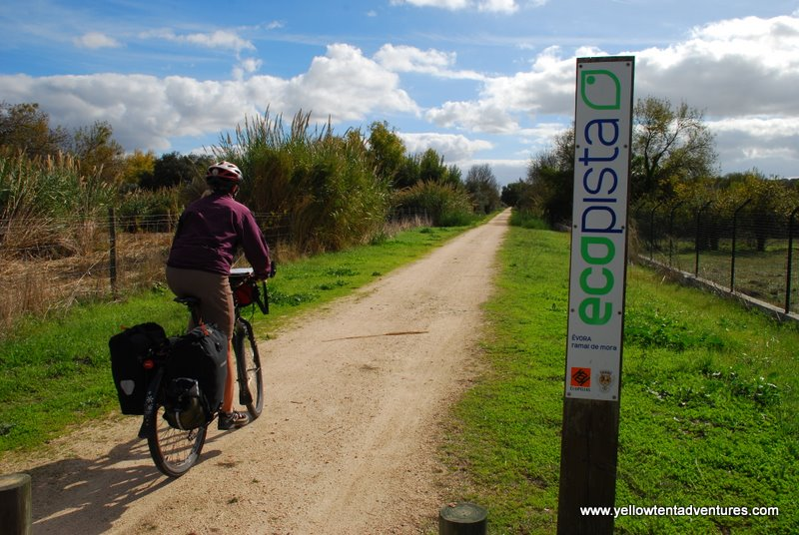
WHAT IS “PUBLIC USE”?
Touristic, educational, interpretative, recreational, and
investigative uses of heritage resources
9

Slide 11
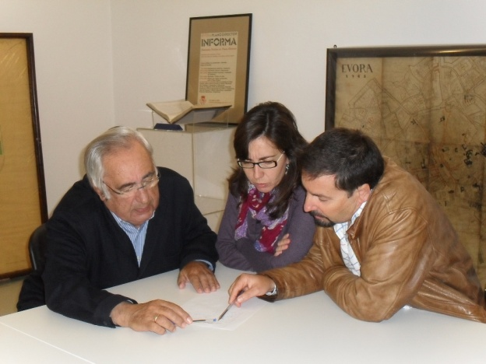
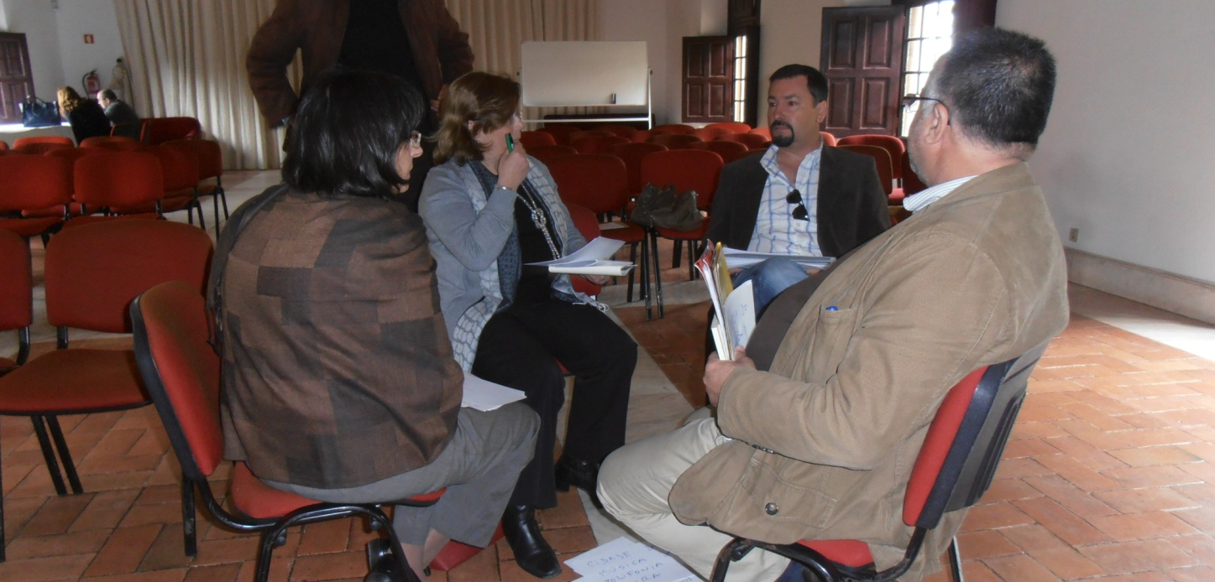
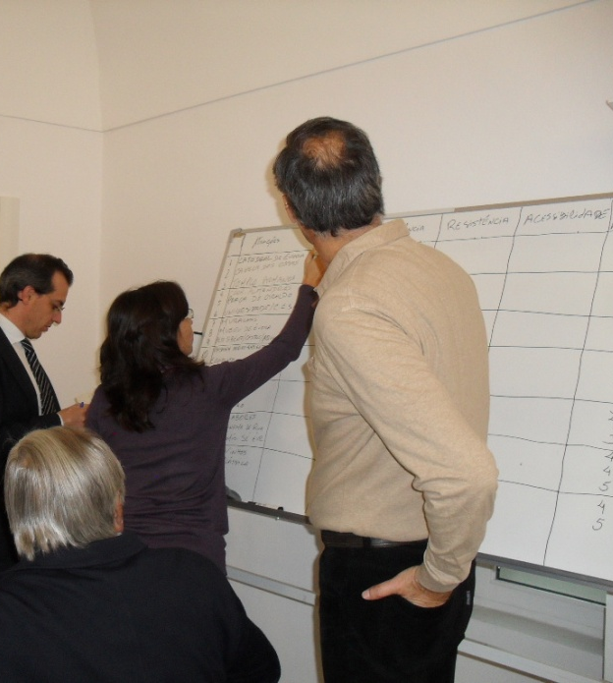
PUP PHILOSOPY
Focus on: Long-term learning
Introducing: Emerging paradigms
New use of outside consultant: From doers to facilitators
10

Slide 12
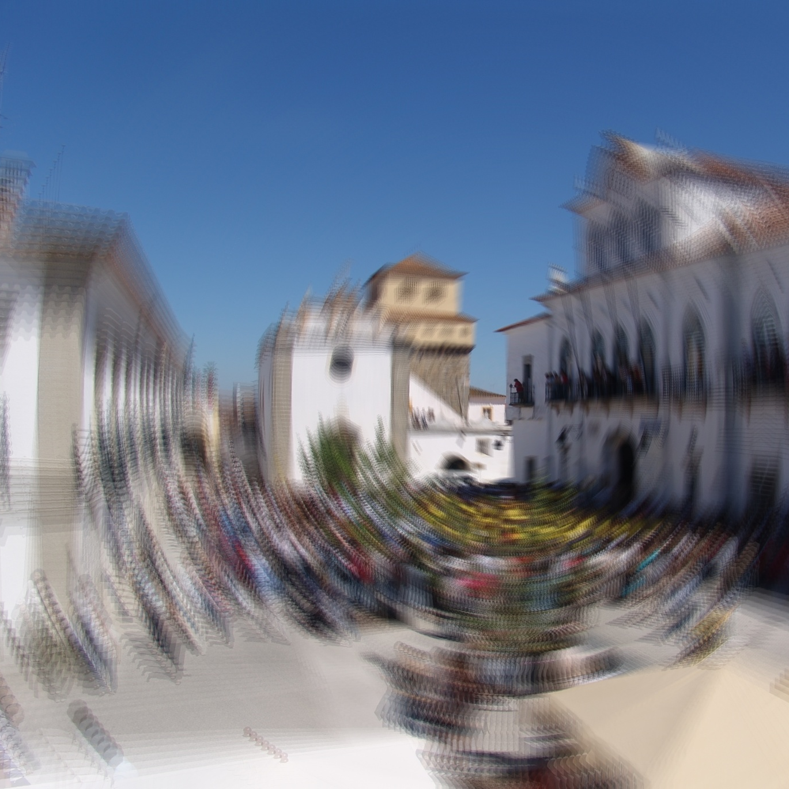
BARRIERS
Sharing power
Assumptions about planning
Organization ineffiency
11

Slide 13
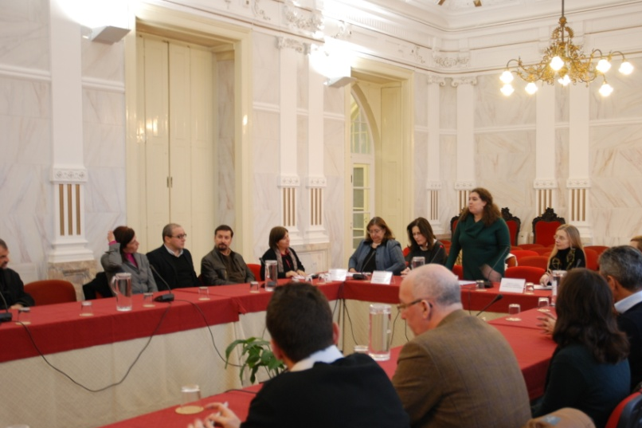
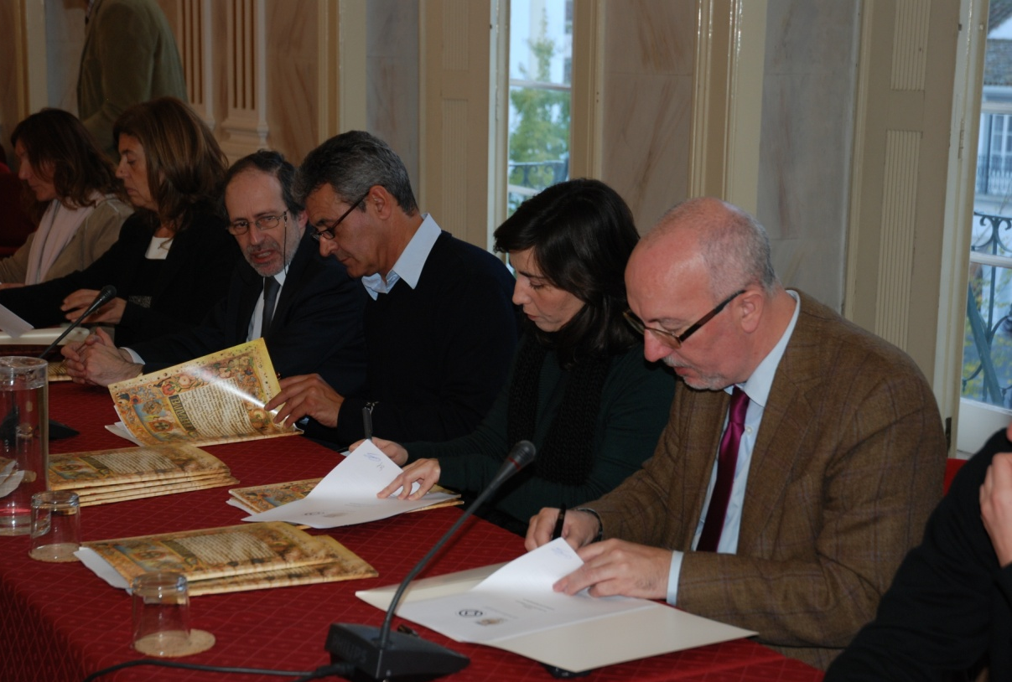
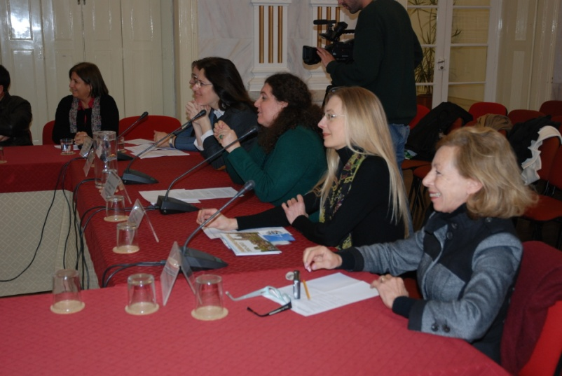
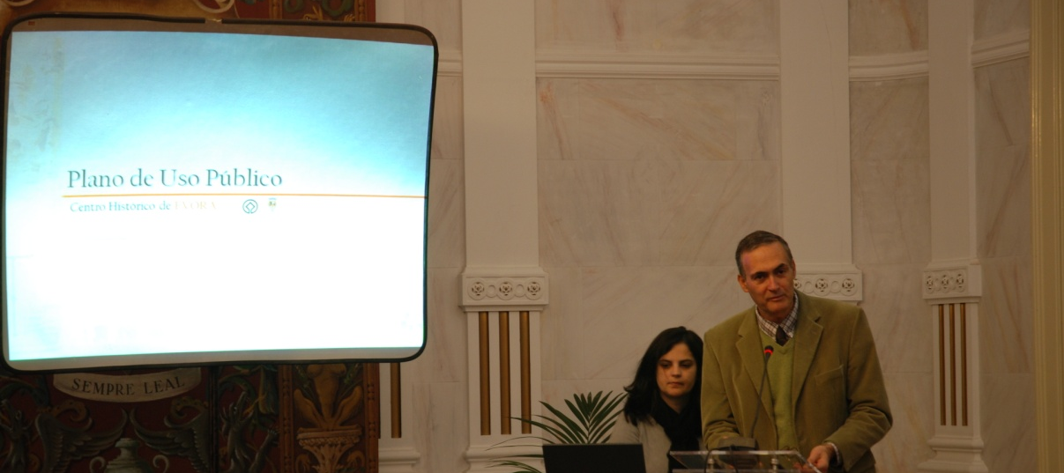
PARTNERS
Signing of «Terms of Reference»
12

Slide 14
PUBLIC USE BEGINS
Planning begins
Implementation begins
13

Slide 15
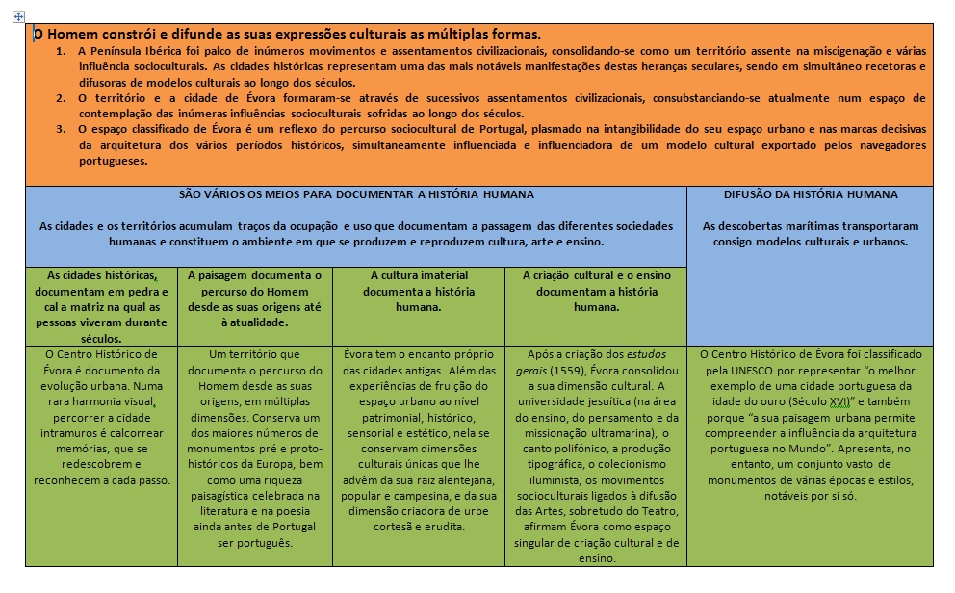
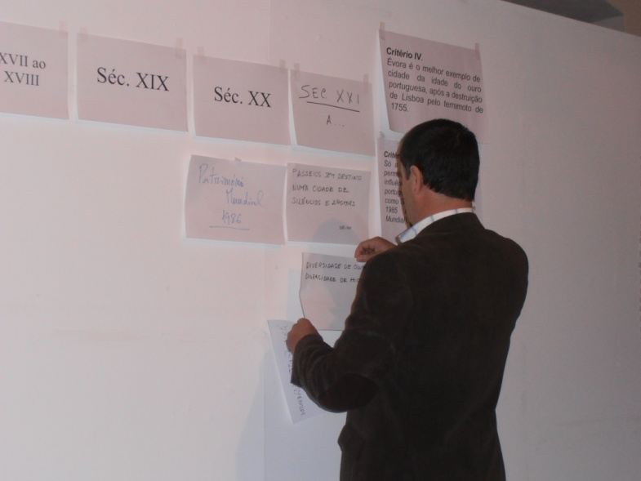
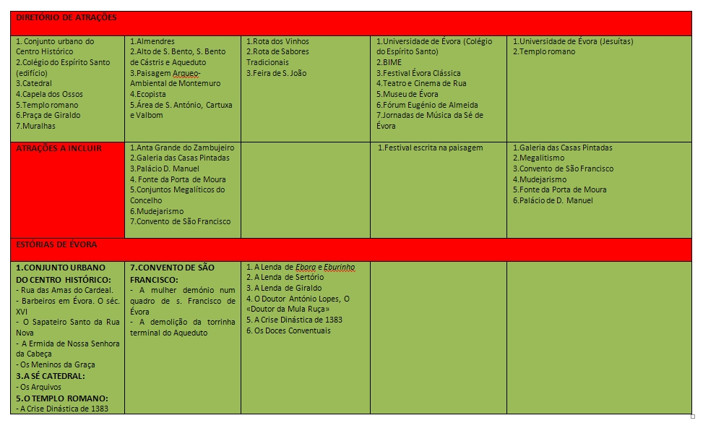
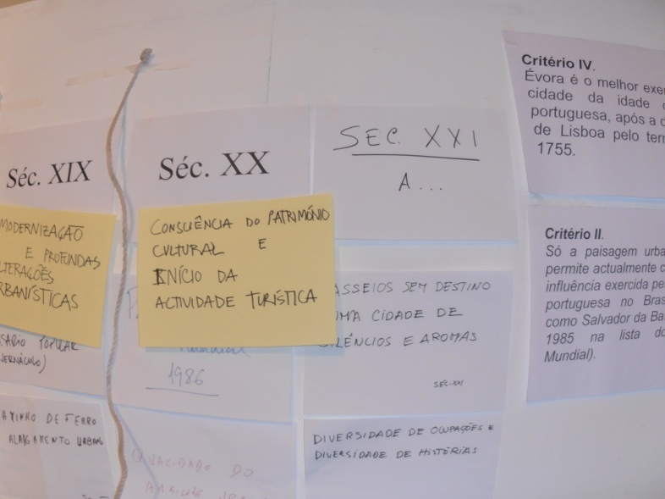
INTERPRETATIVE FRAMEWORK
History
Meanings
Stories
Attributes of Significance
MESSAGES
14

Slide 16
EVORA´S FRAMEWORK
MAN BUILDS AND SHARES HIS CULTURAL EXPRESSIONS IN MULTIPLE WAYS
ATTRIBUTES OF SIGNIFICANCE
- 20000 years of History, Territory and Landscape - Roman Temple - Zambujeiro´s Dolmen
- The human scale
A city of the Discovery period
Evora´s Catedral poliphony singularity - An authentic urban space - Evora of writers, storytellers and travelers
- …
THERE ARE SEVERAL WAYS TO DOCUMENT HUMAN HISTORY
- Historical cities document in stone and lime the matrix in which people live and lived thoroughout the centuries
- The landscape documents man journey from its origins to the present day
- Immaterial culture documents Human History
- Cultural creation and education documents human history
MAN´S JOURNEY
The Historical Centre of Evora was classified by UNESCO for representing “the finest example of a golden age Portuguese city (XVIth century)”, and also because “its urban landscape allows the understanding of portuguese architecture´s influence in the World”. However, it presents in itself a vast set of monuments, of several periods and styles, remarkable on their own.
15

Slide 17
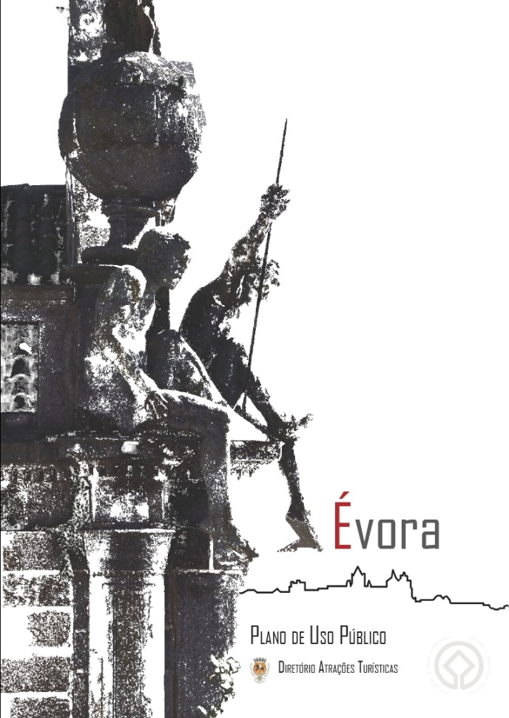
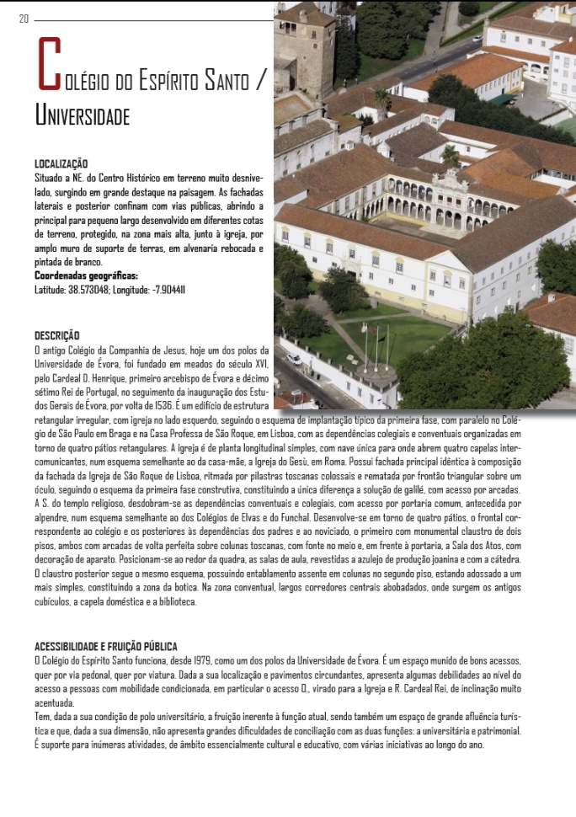
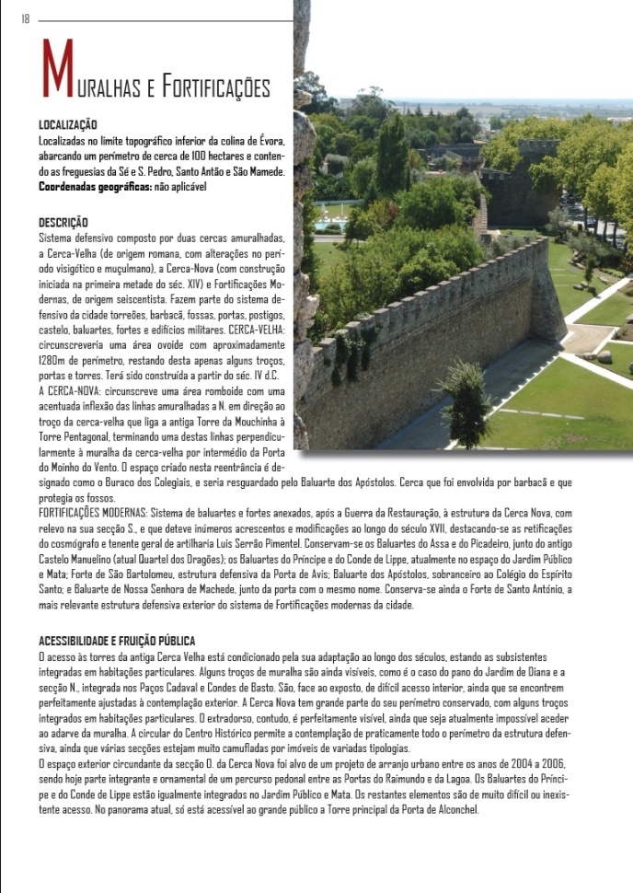
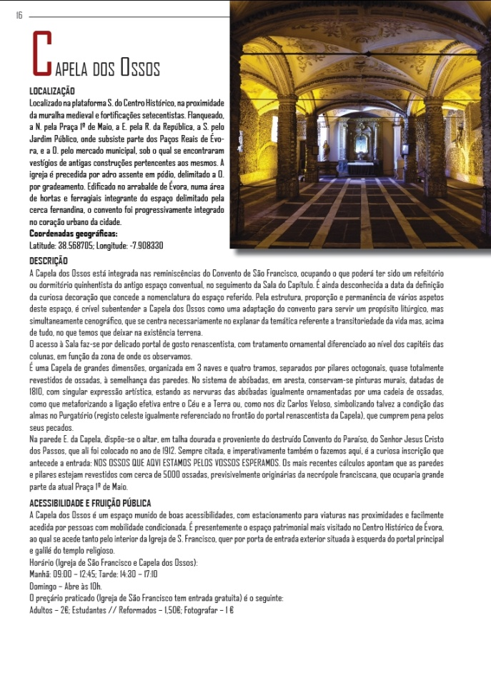
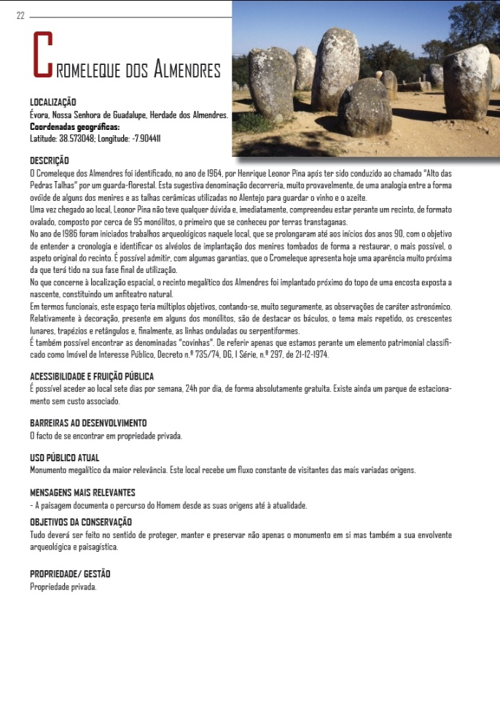
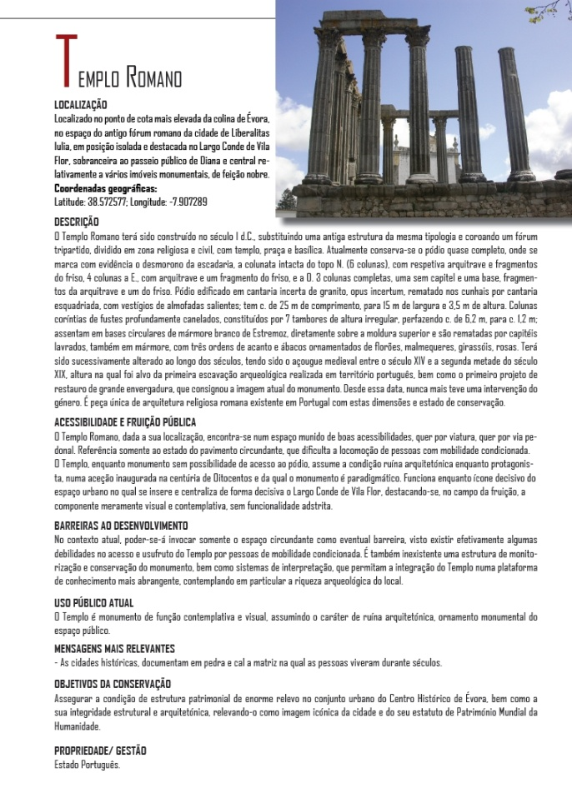
DIRECTORY OF TOURISTIC ATTRACTIONS
PAGES
16

Slide 18
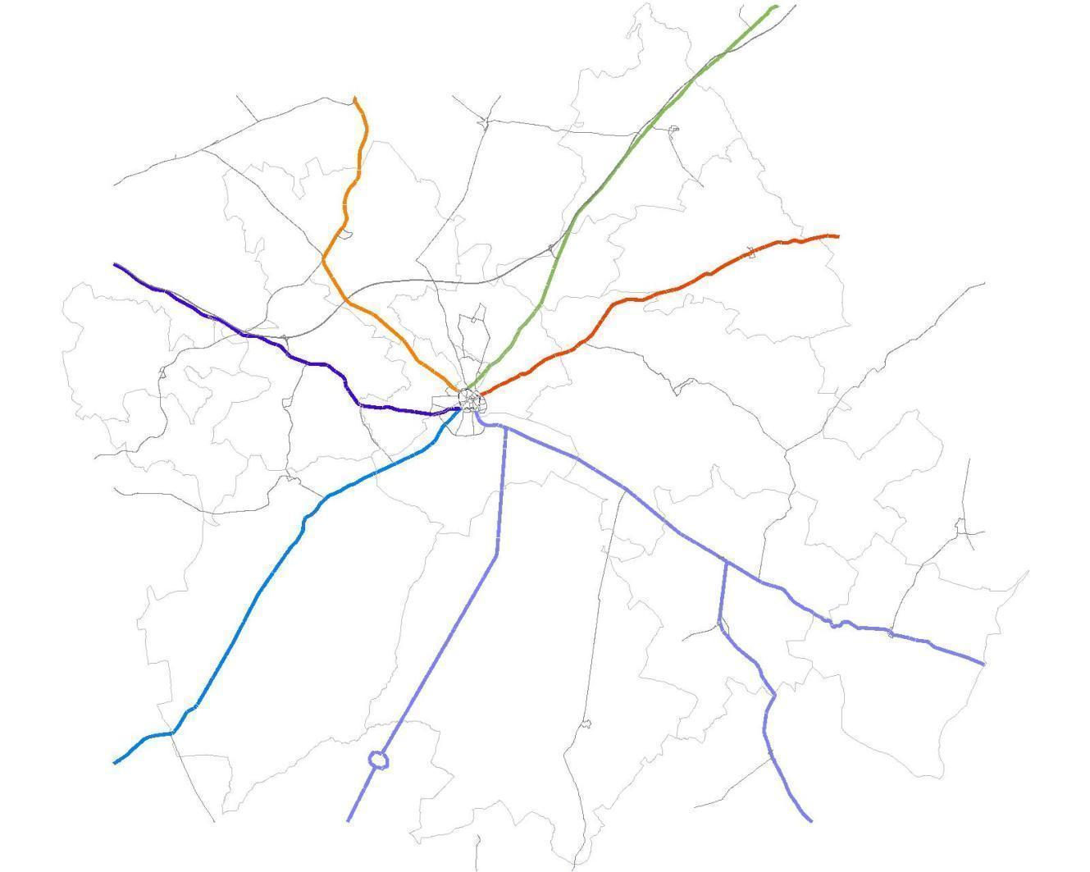
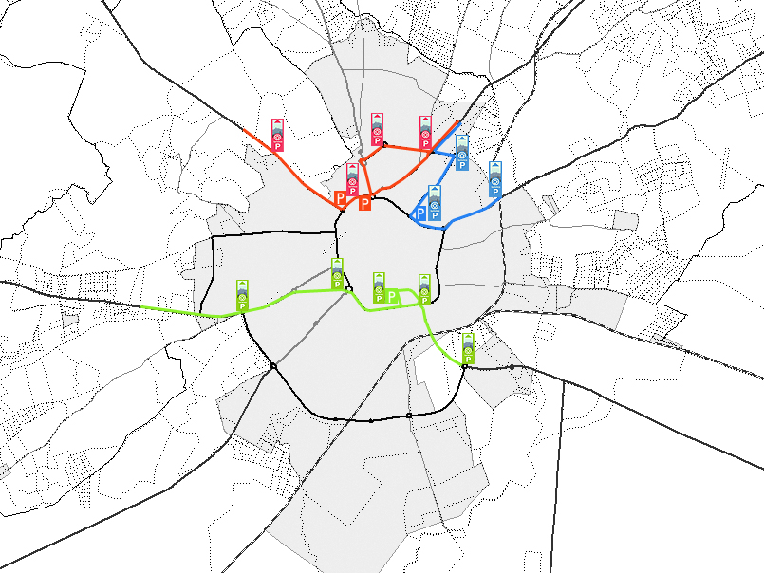
N18|E802|IP2
Estremoz
Espanha
R114-4 Arraiolos
ZONE & SECTOR MAPPING
N114
Montemor-o-Novo
Lisboa
N254
Redondo
N256
Reguengos
de Monsaraz
N380
Alcáçovas
R254
Viana do Alentejo
N18|E802|IP2
Beja
17

Slide 19
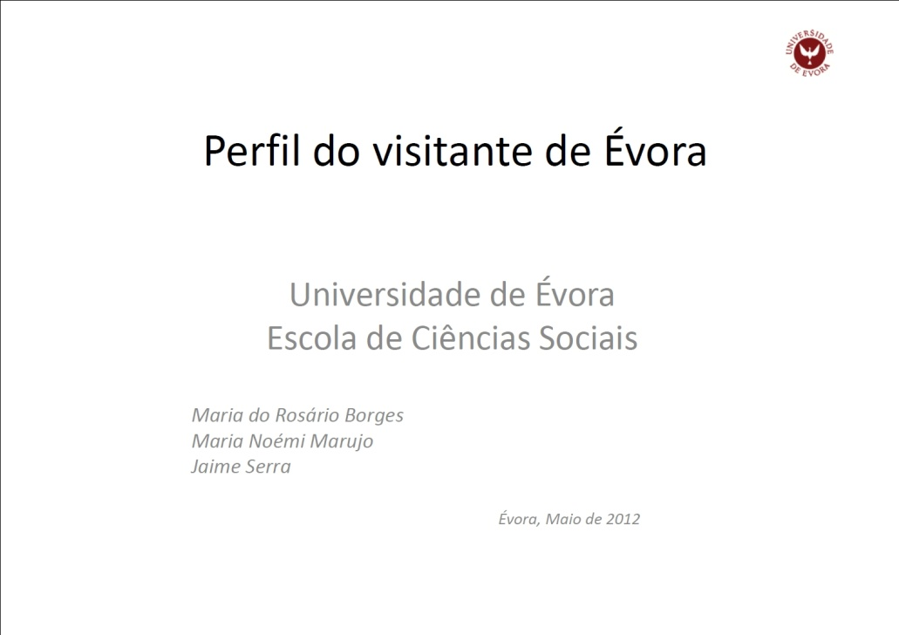
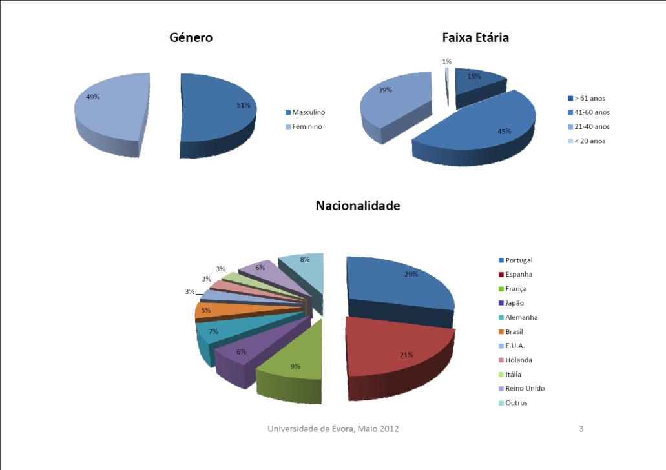
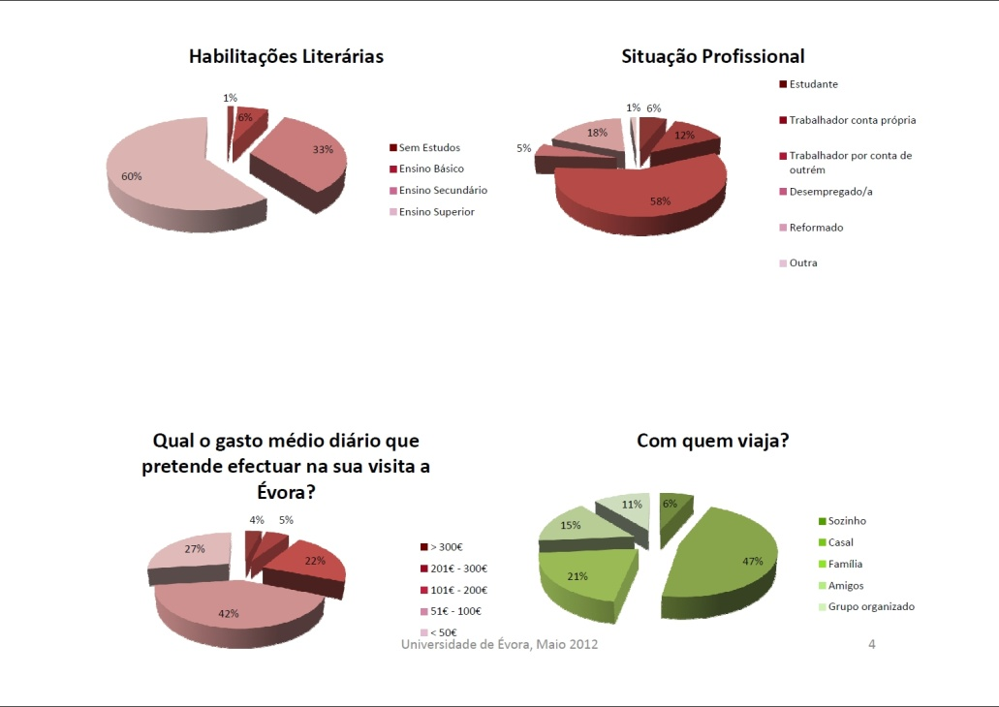
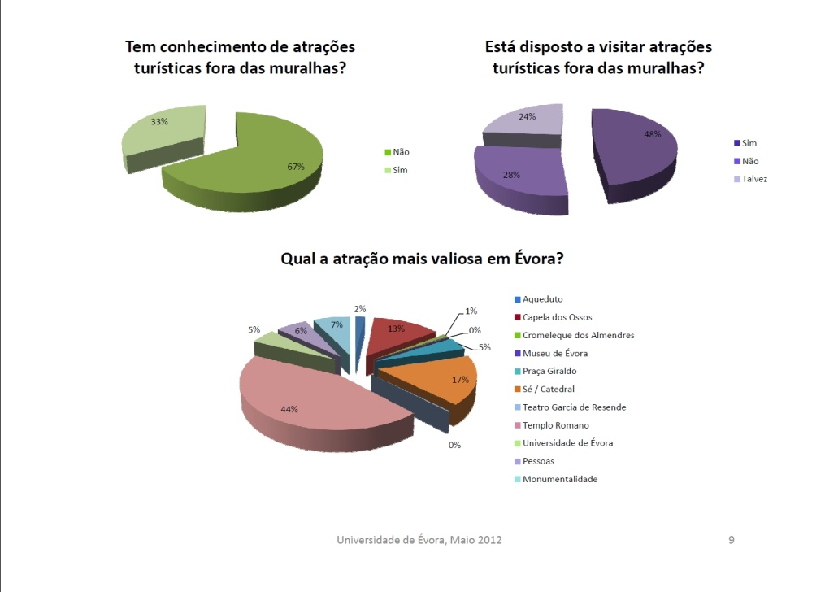
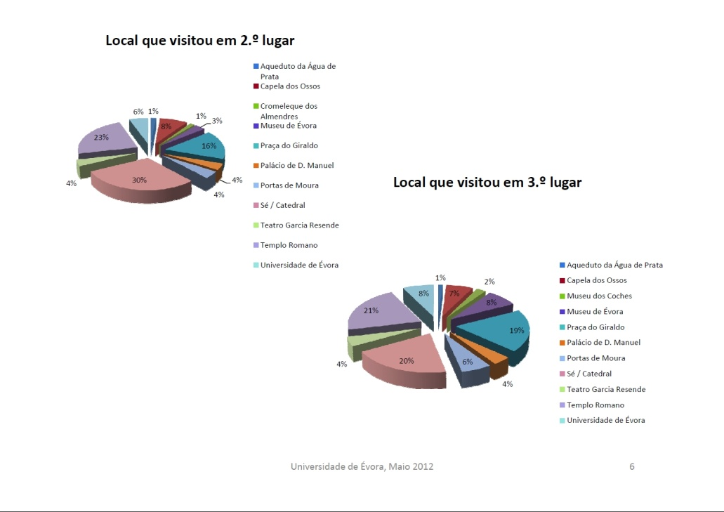
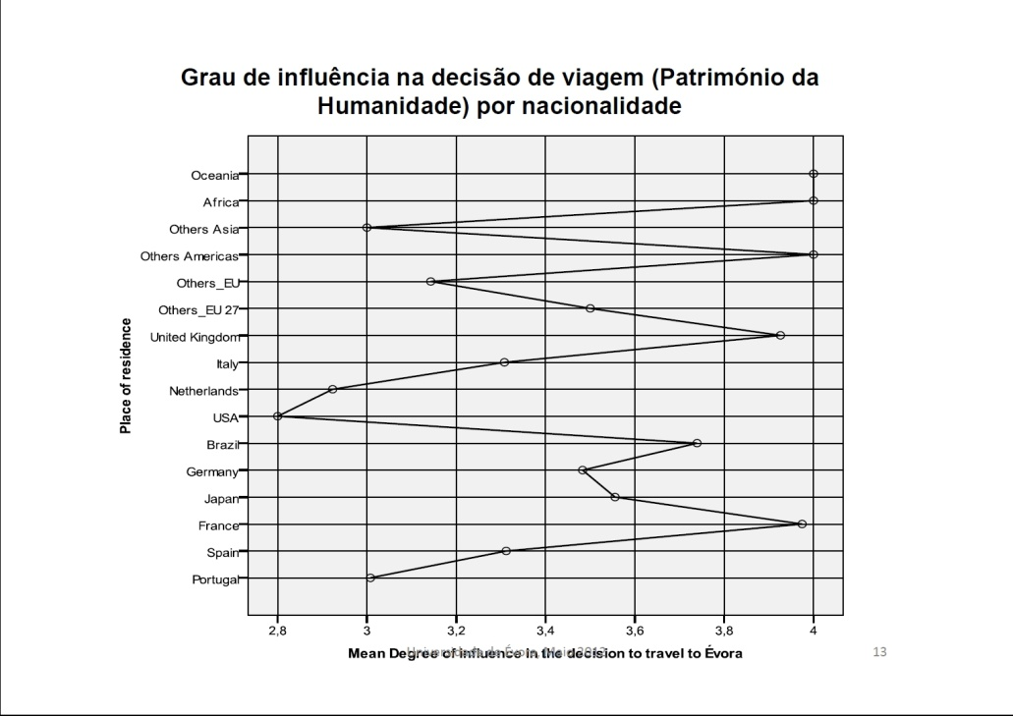
PUBLIC USE PRODUCTS
Kinds of Visitors,
Sector Mapping,
Attractions,
Interpretative Messages,
Management Objectives,
Strategy
18

Slide 20
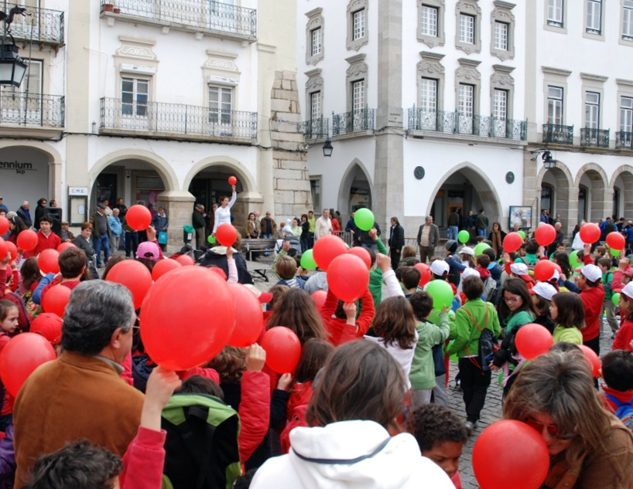
PUBLIC CONSULTATION
Strategic communities
Visitors
MONITORING
Participants determine:
Indicators
Minimal conditions
Limits of acceptable change
BASED ON INTERACTIVE LEARNING AND EXPERIMENTATION
19

Slide 21
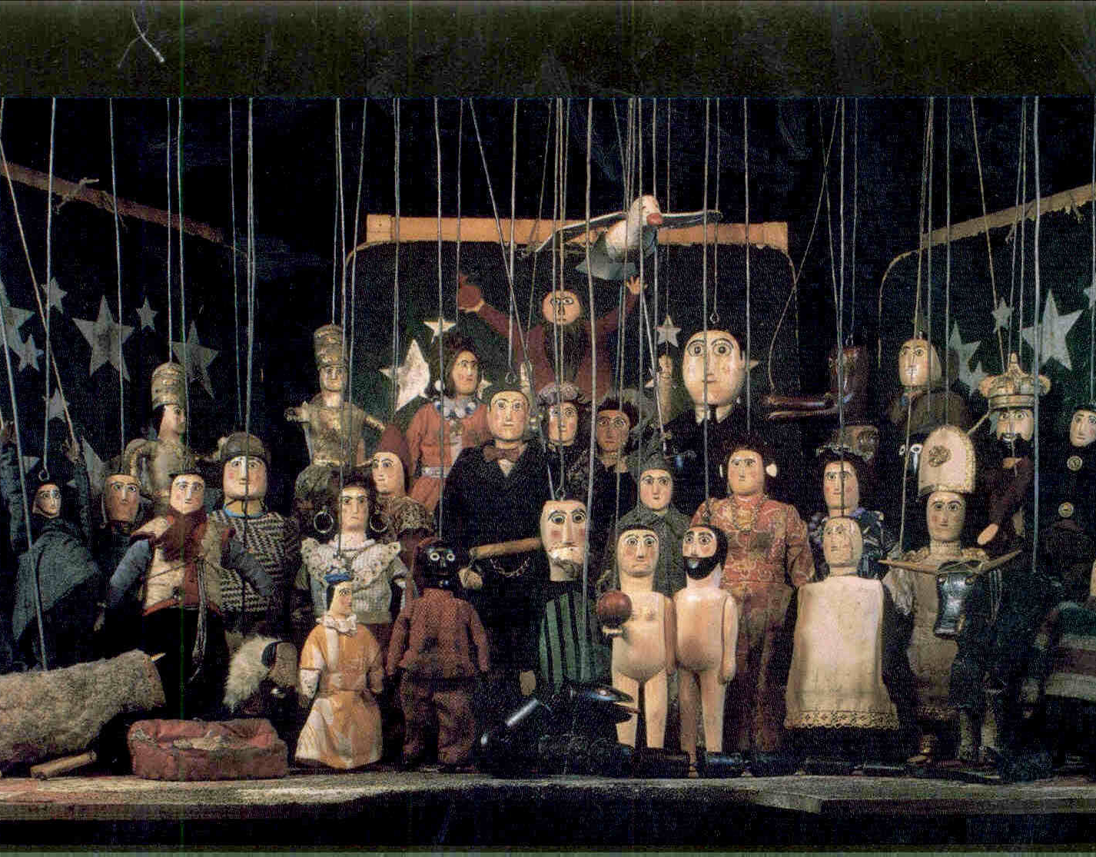
REGULATIONS
Established by consensus among
all stakeholders
CALENDAR of ACTIVITIES
“Who?”
“What?”
“When?”
20

Slide 22
FINANCIAL PLAN
DOCUMENT PREPARATION
IMPLEMENTATION - version 1.0. (of our continuously updated plan)
21

Slide 23
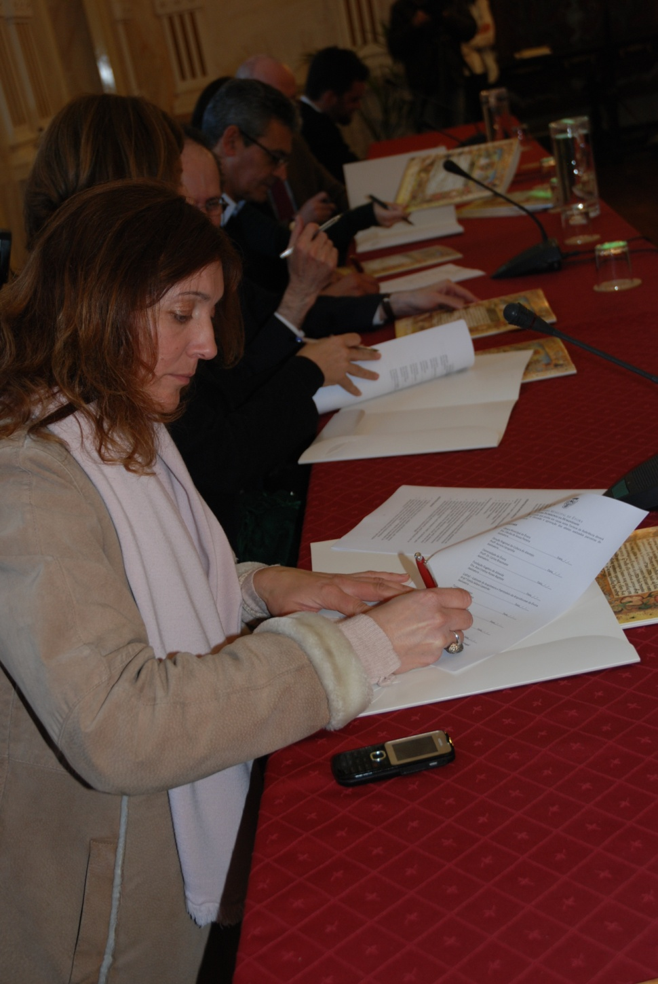
INVOLVEMENT OF CITIZENS
22

Slide 24
INVOLVEMENT OF CITIZENS
23

Slide 25
STRONG POINTS FOR SUSTAINABILITY
Different kinds of relationships
Based on trust
Driven by the beneficiaries
24

Slide 26
STRONG POINTS FOR SUSTAINABILITY
Only through a power sharing process people will feel that they are co creating and thus own the process
Without local resources and ideas, a city can´t become SUSTAINABLE
25

Slide 27
LESSONS LEARNED
Stakeholder participation
Municipalities must play the key role of facilitator
Persistent dialogue and sharing of the decision making pie
26

Slide 28
LESSONS FOR SUSTAINABLE DEVELOPMENT
Local self sufficiency
The predictable formation of a stakeholder advisory body
27

Slide 29
FINAL HIGHLIGHT OF THE PROJECT´S MAIN STRENGTHS
To build the capacity of the site
To identify and avoid barriers
Implementation focuses on the site´s long-term learning
The practice of working together
28

Slide 30
WHY SHOULD ÉVORA BE SELECTED FOR OAXACA
Since Public Use Planning has worked largely in natural sites and cultural landscapes, success in Evora opens up a whole new opportunity for heritage cities around the world
29

Slide 31
WHY SHOULD ÉVORA BE SELECTED FOR OAXACA
If in fact, social cohesion can be increased in Evora that would result in improved heritage management, greater self-sufficiency, and greater mobilization of local resources and ideas not just in this one city but in others around the world.
30

Slide 32
THANK YOU FOR YOUR ATTENTION
TEXT:
Nuno Domingos
Jon Kohl
DESIGN AND GRAPHIC EDITING:
Gustavo Val-Flores
CARTOGRAPHY:
Carlos Almeida
PHOTOS:
José Manuel Rodrigues
João Santos
Gustavo Val-Flores
Maria de Jesus Tenda
IHRU
CME – Arquivo Fotográfico
Francisco Bilou
Nuno Domingos
Jon Kohl

